Slide 1
Chapter 12 Redox Reactions
Wilt Gu

Slide 2
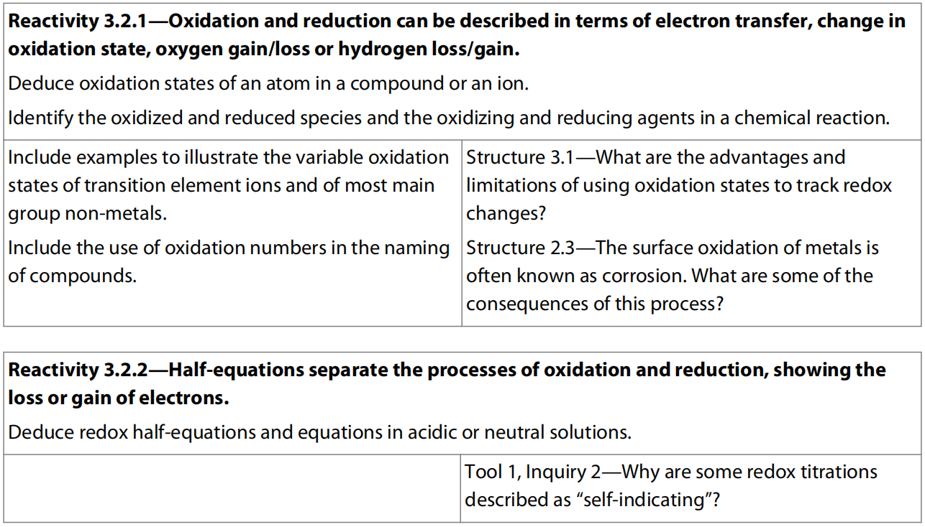
12.1 Oxidation & Reduction

Slide 3
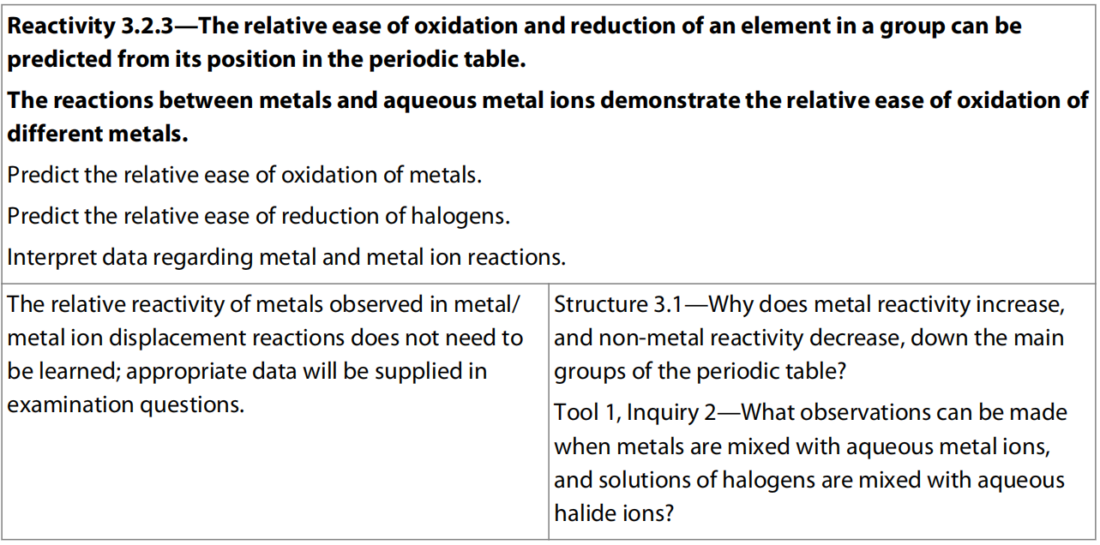

Slide 4
What is Redox Reaction?
Red – Reduction – The process that forms elements from their oxides
Ox – Oxidation – The process that forms oxides from their elements
Redox – Oxidation Reduction
So redox reaction contains both oxidation and reduction

Slide 5
Original Definition of redox
C + O₂ → CO₂
H₂ + CuO → Cu + H₂O
2 Mg + CO₂ → 2 MgO + C
If a substance gains oxygen atom(s) during a reaction, then it undergoes oxidation (been oxidized), and it acts as a reductant.
If a substance loses oxygen atom(s) [or provides oxygen atom(s) to other substance] during a reaction, then it undergoes reduction (been reduced), and it acts as an oxidant.

Slide 6
What about these reactions? Are they also redox reactions?
Zn + 2 HCl → ZnCl₂ + H₂
2 Na + Cl₂ → 2 NaCl
Cu + 4 HNO₃ → Cu(NO₃)₂ + 2 NO₂ + 2 H₂O
If so, then which are the reductants and which are the oxidants? How do you know that?

Slide 7
Extended Definition of Redox
If a substance loses electron(s) during a reaction, then it undergoes oxidation (been oxidized), and it acts as a reductant. At least one of the element in the substance has its oxidation number (also known as valence number) increased.
If a substance gains electron(s) during a reaction, then it undergoes reduction (been reduced), and it acts as an oxidant. At least one of the element in the substance has its oxidation number decreased.

Slide 8
OXIDATION — loss of electron(s) by a species; increase in oxidation number; increase in oxygen atom.
REDUCTION — gain of electron(s); decrease in oxidation number; decrease in oxygen atom; increase in hydrogen atom.
OXIDIZING AGENT (OXIDANT) — electron acceptor; species is reduced. (an agent facilitates something; ex. Travel agents don’t travel, they facilitate travel)
REDUCING AGENT (REDUCTANT) — electron donor; species is oxidized.

Slide 9
Method to remember this
LEO (the lion) goes to GER (or 劉喆?)
Loss of Electrons is Oxidation;
Gain of Electrons is Reduction.

Slide 10
Oxidation and Reduction are always company with each other
Electrons are actually transferred from reductant to oxidant during the reaction so oxidation should always be company with reduction.
The total number of electrons loss by the reductant should equal to the total number of electrons gained by the oxidant.

Slide 11
Any reactions that contain transfer of electrons are all redox reactions.
Any reactions that contain change of oxidation number for any of the elements involved are all redox reactions.
All chemical reactions can be divided in 2 categories:
Redox reaction and Non-redox reaction

Slide 12
Relationship of redox reaction and the 4 basic reaction types
Decomposition Reaction
Combination Reaction
Redox Reaction
Single Displacement Reaction
Double Displacement Reaction
Non-Redox Reaction

Slide 13
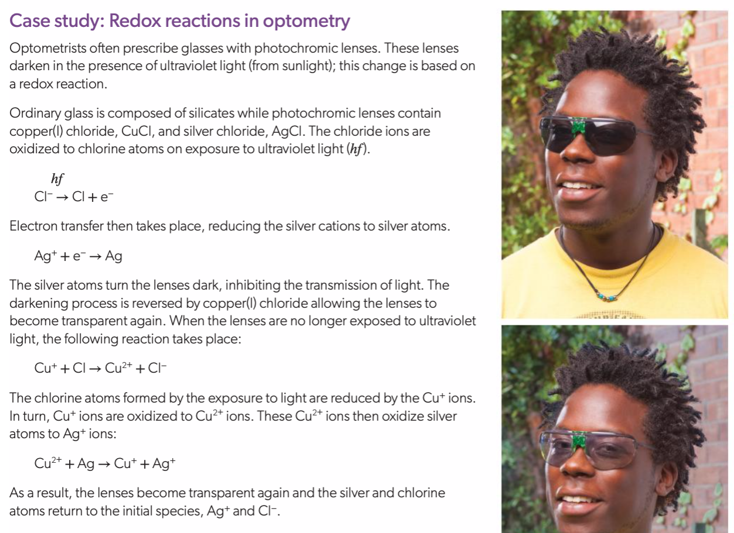

Slide 14
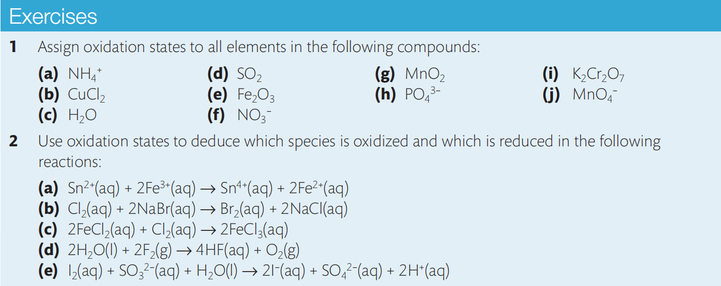
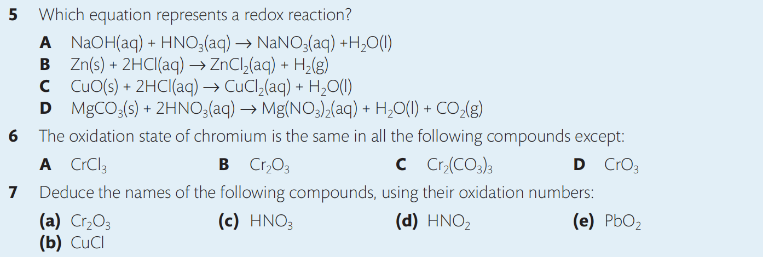

Slide 15
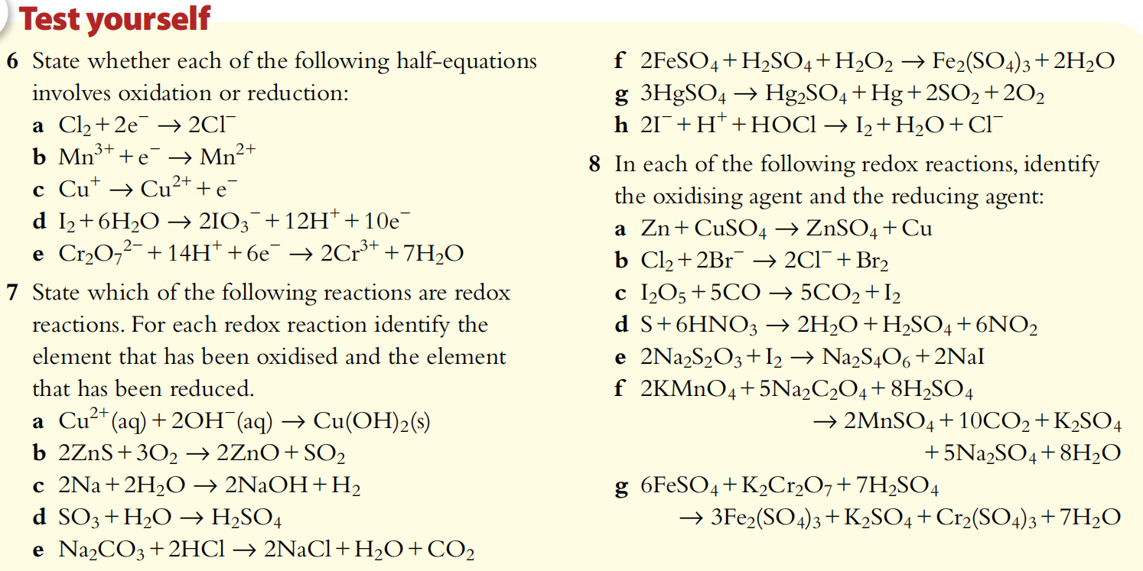

Slide 16
Half Equations
In terms of transfer of electrons, a specific equation that includes electron(s) can be constructed to show either reduction or oxidation process.
E.g.:
Oxidation: Zn(s) → Zn²⁺(aq) + 2 e⁻
loss of electrons (e⁻ on the right)
Reduction: 2 H⁺(aq) + 2 e⁻ → H₂(g)
gain of electrons (e⁻ on the left)
These equations are known as half equations. They can be combined together with balancing to cancel out the electrons to get the balanced full equation of the redox reaction. So in this case the full equation is:
Zn(s) + 2 H⁺(aq) → Zn²⁺(aq) + H₂(g)

Slide 17
Half equations must be balanced in the same way as normal equations (with respect to number of atoms of each element and charge), the only difference being that they contain electrons and the total charges on both sides need to be equal to each other.
When constructing a half equation it is easier to follow a sequence of steps.

Slide 18
E.g.: Construct the half equation for the reduction of chlorine gas to chloride ion in a solution:
Cl₂(aq) → Cl⁻(aq)
1) Balance the number of atoms of the element being oxidized or reduced on the two sides:
Cl₂(aq) → 2 Cl⁻(aq)
2) Add electrons so that the electrical charges on both sides balance:
Cl₂(aq) + 2 e⁻ → 2 Cl⁻(aq)

Slide 19
Exercise
Construct the half equations as required.
Al(s) → Al³⁺(aq)
S(s) → S²⁻(aq)
O₂(g) → O²⁻(l)
Fe²⁺(aq) → Fe³⁺(aq)
Cr₂O₇²⁻(aq) → Cr³⁺(aq)
Check out
Al(s) → Al³⁺(aq) + 3 e⁻
S(s) + 2 e⁻ → S²⁻(aq)
O₂(g) + 4 e⁻ → 2 O²⁻(l)
Fe²⁺(aq) → Fe³⁺(aq) + e⁻
Cr₂O₇²⁻(aq) → Cr³⁺(aq) ???

Slide 20
Balancing half equations with other species added in (acidic solution)
What if the reactant and the product cannot be balanced directly by adding coefficient on any of them?
E.g.: Construct the half equation for the reduction of the orange dichromate (VI) ion to the green chromium (III) ion in an acidic solution:
Cr₂O₇²⁻(aq) → Cr³⁺(aq)
Then we need some more steps in the whole process to eventually balance it.
For acidic solution, H⁺ could be one of the reactants or products rather than just being spectator ions, and water are always reasonably to be consumed or to be produced.

Slide 21
1) Balance the number of atoms of the element being oxidized or reduced (in this case Cr is being reduced from +6 to +3) on the two sides (if needed):
Cr₂O₇²⁻(aq) → 2 Cr³⁺(aq)
2) Add water molecules to balance the number of oxygen atoms on the two sides (if needed):
Cr₂O₇²⁻(aq) → 2 Cr³⁺(aq) + 7 H₂O(l)
3) Add hydrogen ions to balance the number of hydrogen atoms on the two sides (if needed):
Cr₂O₇²⁻(aq) + 14 H⁺(aq) → 2 Cr³⁺(aq) + 7 H₂O(l)
4) Add electrons so that the electrical charges on both sides balance:
Cr₂O₇²⁻(aq) + 14 H⁺(aq) + 6 e⁻ → 2 Cr³⁺(aq) + 7 H₂O(l)

Slide 22
Alternatively:
1) Balance the number of atoms of the element being oxidized or reduced (in this case Cr is being reduced from +6 to +3) on the two sides (if needed):
Cr₂O₇²⁻(aq) → 2 Cr³⁺(aq)
2) Add electrons according to the oxidation number change of the species that is oxidized or reduced:
Cr₂O₇²⁻(aq) + 6 e⁻ → 2 Cr³⁺(aq)
3) Add hydrogen ions to balance charge on both sides (if needed):
Cr₂O₇²⁻(aq) + 14 H⁺(aq) + 6 e⁻ → 2 Cr³⁺(aq)
4) Add water molecules to balance the number of oxygen and hydrogen atoms on the two sides (if needed):
Cr₂O₇²⁻(aq) + 14 H⁺(aq) + 6 e⁻ → 2 Cr³⁺(aq) + 7 H₂O(l)

Slide 23
Exercise
Construct the half equation of the following process in an acidic solution.
NO₃⁻(aq) → NO₂(g)
H₂O₂(aq) → H₂O(l)
MnO₄⁻(aq) → Mn²⁺(aq)
Check out
NO₃⁻(aq) + 2 H⁺(aq) + e⁻ → NO₂(g) + H₂O(l)
H₂O₂(aq) + 2 H⁺(aq) + 2 e⁻ → 2 H₂O(l)
MnO₄⁻(aq) + 8 H⁺(aq) + 5 e⁻ → Mn²⁺(aq) + 4 H₂O(l)

Slide 24
Balancing half equations with other species added in (neutral solution)
For neutral solution, only water can be used as extra reactant but the products can include H⁺ or OH⁻.
E.g.: Construct the half equation for the oxidation of the extremely toxic phosphine (PH₃) to phosphoric acid (H₃PO₄) in a neutral solution:
PH₃(g) → H₃PO₄(aq)

Slide 25
1) Balance the number of atoms of the element being oxidized or reduced (in this case PH₃ is being oxidized from -3 to +5) on the two sides (if needed):
PH₃(g) → H₃PO₄(aq)
2) Add electrons so that the electrical charges on both sides balance:
PH₃(g) → H₃PO₄(aq) + 8 e⁻
Add H⁺ or OH⁻ ON THE RIGHT HAND SIDE to balance the charge (if needed):
PH₃(g) → H₃PO₄(aq) + 8 e⁻ + 8 H⁺(aq)
3) Add water (normally on left hand side) to balance the number of O atoms and H atoms on both sides (if needed):
PH₃(g) + 4 H₂O(l) → H₃PO₄(aq) + 8 e⁻ + 8 H⁺(aq)

Slide 26
Exercise
Construct the half equation of the following process in an neutral solution.
MnO₂(s) → Mn(OH)₂(s)
H₂S(g) → S(s)
NO₃⁻(aq) → N₂(g)
Check out
MnO₂(s) + 2 H₂O(l) + 2 e⁻ → Mn(OH)₂(s) + 2 OH⁻(aq)
H₂S(g) → S(s) + 2 H⁺(aq) + 2 e⁻
2 NO₃⁻(aq) + 6 H₂O(l) + 10 e⁻ → N₂ (g) + 12 OH⁻(aq)

Slide 27
Balancing half equations with other species added in (basic solution) (not required)
For reactions taking place in basic solution, their should not be much of H⁺ in basic solution so we cannot include H⁺ in the equation, but to include OH⁻ instead.
OH⁻ could be one of the reactants or products rather than just being spectator ions, and water are always reasonably to be consumed or to be produced.
E.g.: Construct a half equation for the oxidation of chlorine gas to form chlorate ion in a basic condition:
Cl₂(aq) → ClO₃⁻(aq)

Slide 28
1) Balance the number of atoms of the element being oxidized or reduced (in this case Cl is being oxidized from 0 to +5) on the two sides (if needed):
Cl₂(aq) → 2 ClO₃⁻(aq)
2) Add water molecules on the side that has more O atoms to make the number of excess O atoms and excess H atoms equal on this side (if needed):
Cl₂(aq) → 2 ClO₃⁻(aq) + 6 H₂O(l)
3) Add hydroxide ions to balance the number of O atoms and H atoms on both sides (if needed):
Cl₂(aq) + 12 OH⁻(aq) → 2 ClO₃⁻(aq) + 6 H₂O(l)
4) Add electrons so that the electrical charges on both sides balance:
Cl₂(aq) + 12 OH⁻(aq) → 2 ClO₃⁻(aq) + 6 H₂O(l) + 10 e⁻

Slide 29
Alternatively:
1) Balance the number of atoms of the element being oxidized or reduced (in this case Cl is being oxidized from 0 to +5) on the two sides (if needed):
Cl₂(aq) → 2 ClO₃⁻(aq)
2) Add electrons according to the oxidation number change of the species that is oxidized or reduced:
Cl₂(aq) → 2 ClO₃⁻(aq) + 10 e⁻
3) Add hydroxide ions to balance the charge on both sides (if needed):
Cl₂(aq) + 12 OH⁻(aq) → 2 ClO₃⁻(aq) + 10 e⁻
4) Add water molecules to balance the number of O atoms and H atoms on both side (if needed):
Cl₂(aq) + 12 OH⁻(aq) → 2 ClO₃⁻(aq) + 6 H₂O(l) + 10 e⁻

Slide 30
Exercise
Construct the half equation of the following process in an basic solution.
CrO₄²⁻(aq) → Cr(OH)₃(s)
H₂O₂(aq) → OH⁻(aq)
S(s) → SO₃²⁻(aq)
Check out
CrO₄²⁻(aq) + 4 H₂O(l) + 3 e⁻ → Cr(OH)₃(s) + 5 OH⁻(aq)
H₂O₂(aq) + 2 e⁻ → 2 OH⁻(aq)
S(s) + 6 OH⁻(aq) → SO₃²⁻(aq) + 3 H₂O(l) + 4 e⁻

Slide 31
Balancing Redox reaction using half equations
When combining the two half equations, the electrons in the equations need to be eventually cancelled out.
E.g.: Construct a balance equation of the redox reaction occurs in an acidic solution:
Reduction: Cr₂O₇²⁻(aq) → Cr³⁺(aq)
Oxidation: Pb²⁺(aq) → PbO₂(s)
First, construct the two half equations:
Reduction: Cr₂O₇²⁻(aq) + 14 H⁺(aq) + 6 e⁻ → 2 Cr³⁺(aq) + 7 H₂O(l)
Oxidation: Pb²⁺(aq) + 2 H₂O(l) → PbO₂(s) + 4 H⁺(aq) + 2 e⁻

Slide 32
Multiply ALL the coefficients of one or both of the half equations by (different) whole number(s) to make the number of electrons in both equations become the same:
Reduction: Cr₂O₇²⁻(aq) + 14 H⁺(aq) + 6 e⁻ → 2 Cr³⁺(aq) + 7 H₂O(l)
Oxidation: 3 Pb²⁺(aq) + 6 H₂O(l) → 3 PbO₂(s) + 12 H⁺(aq) + 6 e⁻
Add the two half equations together with the cancellation of electrons to get full equation.
Cr₂O₇²⁻(aq) + 14 H⁺(aq) + 3 Pb²⁺(aq) + 6 H₂O(l)
→ 2 Cr³⁺(aq) + 3 PbO₂(aq) + 7 H₂O(l) + 12 H⁺(aq)
Cancel the substances that appear at both sides of the reaction.
Cr₂O₇²⁻(aq) + 2 H⁺(aq) + 3 Pb²⁺(aq)
→ 2 Cr³⁺(aq) + 3 PbO₂(aq) + H₂O(l)

Slide 33
Exercise
Construct the half equations and balanced full equation with state symbols, given the information:
Oxidation: sulfur dioxide → sulfate ion
Reduction: permanganate ion → manganese (II) ion
The process occurs in an acidic solution
Check out:
Oxidation: SO₂(aq) + 2 H₂O(l) → SO₄²⁻(aq) + 4 H⁺(aq) + 2 e⁻
Reduction: MnO₄⁻(aq) + 8 H⁺(aq) + 5 e⁻
→ Mn²⁺(aq) + 4H₂O (l)
Full equation: 2 MnO₄⁻(aq) + 5 SO₂(aq) + 2 H₂O(l)
→ 2 Mn²⁺(aq) + 5 SO₄²⁻(aq) + 4 H⁺(aq)

Slide 35
Balancing Chemical Equations by balancing oxidation number change
Balance: Mg + HNO₃ → Mg(NO₃)₂ + N₂ + H₂O
To balance a redox equation, follow the steps shown below:
1. Identify the substances that contain elements with oxidation number increased or decreased in the reaction:
Increase: Mg → Mg(NO₃)₂ (0 → +2)
Decrease: HNO₃ → N₂ (+5 → 0)
2. Calculate the total number of oxidation number increase and decrease in the equation:
Increase: +2 - 0 = 2
Decrease: 2 × (+5 – 0) = 10 (there are 2 N atoms in N₂, both decreased their oxidation number by 5)

Slide 36
3. Balance the oxidation number change (total increase = total decrease) by assigning coefficients on the relevant substance (in this case some of the N atoms in HNO₃ changed their oxidation number but still some others remained the same in Mg(NO₃)₂, so leave it alone for a while):
5 Mg + HNO₃ → 5 Mg(NO₃)₂ + (1) N₂ + H₂O
4. Balance the number of atoms for each element by adding coefficients to substances that have not been assigned with coefficient yet (BE AWARE: DO NOT change any assigned coefficients):
5 Mg + 12 HNO₃ → 5 Mg(NO₃)₂ + N₂ + 6 H₂O

Slide 37
Exercises
Balance the following chemical equations:
CH₄ + CuO → Cu + CO₂ + H₂O
NO + O₂ + H₂O → HNO₃
Cu + HNO₃ → Cu(NO₃)₂ + NO + H₂O
Cl₂ + KOH → KCl + KClO₃ + H₂O
Check out:
CH₄ + 4 CuO → 4 Cu + CO₂ + 2 H₂O
4 NO + 3 O₂ + 2 H₂O → 4 HNO₃
3 Cu + 8 HNO₃ → 3 Cu(NO₃)₂ + 2 NO + 4 H₂O
3 Cl₂ + 6 KOH → 5 KCl + KClO₃ + 3 H₂O

Slide 38
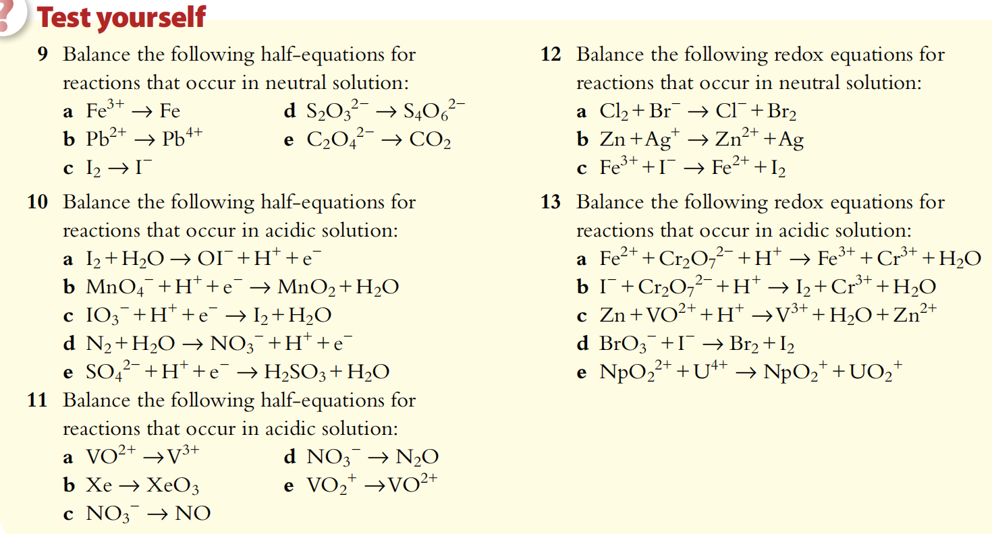

Slide 39
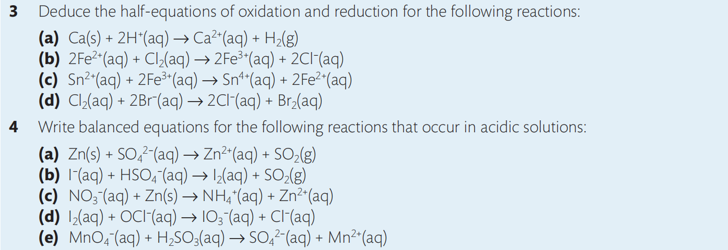
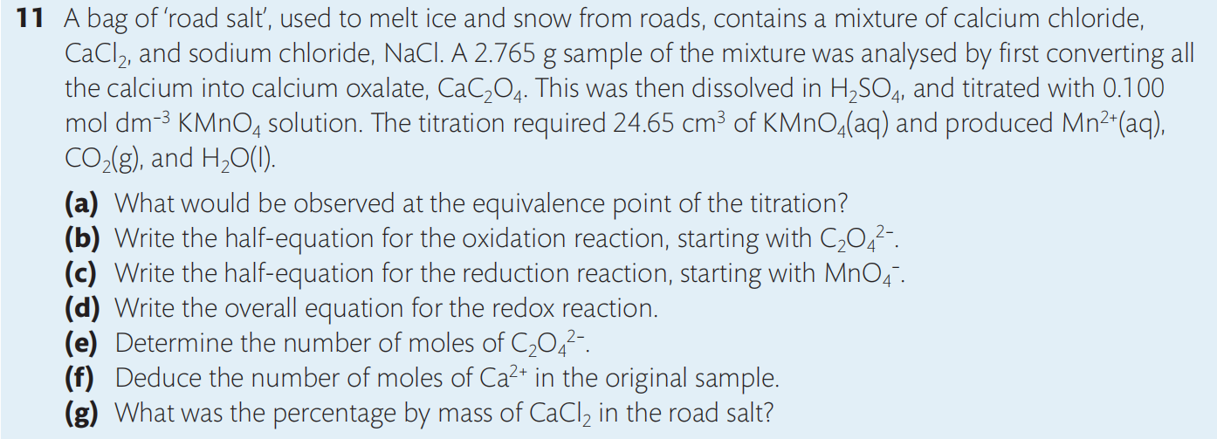

Slide 40
Relationship of Oxidation State and Reducibility / Oxidizability
Elements that are at their highest oxidation state can only oxidize / be reduced by other elements
E.g.: HNO₃, conc. H₂SO₄, MnO₄⁻, Cr₂O₇²⁻, F₂, Fe³⁺
Elements that at their lowest oxidation state can only reduce / be oxidized by other elements
E.g.: S²⁻, I⁻, Zn, Mg, HCl
Elements that are neither at their lowest nor at their highest oxidation state can both reduce / be oxidized and oxidize / be reduced by other elements
E.g.: SO₂, Cl₂, Fe²⁺, CO

Slide 41
Common Oxidants and Reductants
(1) Common Oxidants
Reactive nonmetals: F₂, Cl₂, Br₂, O₂
X₂(g) + 2 e⁻ → 2 X⁻ (aq) (X = F, Cl, Br)
O₂(g) + 4 H⁺(aq) + 4 e⁻ → 2 H₂O(l) (acidic condition)
O₂(g) + 2 H₂O(l) + 4 e⁻ → 4 OH⁻(aq) (neutral or basic condition)
Metal cations (oxides) with higher oxidation number: Fe³⁺, PbO₂
Fe³⁺(aq) + e⁻ → Fe²⁺(aq)
PbO₂(s) + 4 H⁺(aq) + 2 e⁻ → Pb²⁺(aq)+ 2 H₂O(l)
Oxyacids with higher oxidation number and their corresponding anions: MnO₄⁻, Cr₂O₇²⁻, HNO₃, conc. H₂SO₄
4 H⁺(aq) + NO₃⁻(aq) + 3 e⁻ → NO(g) + 2 H₂O(l)
Peroxides: H₂O₂, Na₂O₂
H₂O₂(aq) + 2 e⁻ → 2 OH⁻(aq) (neutral or basic condition)
H₂O₂(aq) + 2 H⁺(aq) + 2 e⁻ → 2 H₂O(l) (acidic condition)

Slide 42
(2) Common Reductants
Reactive metals: alkali metals (Na, K, Cs, …), alkaline earth metals (Mg, Ca, Ba, …), Al, Fe, Zn
M(s) → M²⁺(aq) + 2 e⁻ (M = group 2 metals, Zn)
Al(s) → Al³⁺(aq) + 3 e⁻
Some nonmetals: H₂, C (only under relatively high temp.)
C + 2 MO → CO₂ + 2 M (M = metals with moderate reactivity)
Substances with lower oxidation number: CO, Fe²⁺, I⁻, S²⁻, SO₃²⁻, S₂O₃²⁻
Fe²⁺(aq) → Fe³⁺(aq) + e⁻
2 I⁻(aq) → I₂(aq) + 2 e⁻
2 S₂O₃²⁻(aq) + I₂(aq) → S₄O₆²⁻(aq) + 2 I⁻(aq)
SO₂(aq) + 2 H₂O(l) → SO₄²⁻(aq) + 4 H⁺(aq) + 2 e–
S²⁻(aq) → S(s) + 2 e⁻

Slide 43
Strength of Oxidants and Reductants
The more readily a substance can gain electrons from others, the stronger the oxidant;
The more readily a substance can provide electrons to others, the stronger the reductant.

Slide 44
For metal elements, the lower electronegativity of a metal, the stronger reductant it is, the weaker oxidant its corresponding cation is.
E.g.: reducibility: Mg > Zn, oxidizability: Mg²⁺ < Zn²⁺
Or using metal activity series to determine:
K>Na>Ca>Mg>Al>Zn>Fe>Sn>Pb>(H)>Cu>Hg>Ag>Pt>Au
For halogen elements, the higher electronegativity of a halogen element, the stronger oxidant it is, the weaker reductant its corresponding anion is.
E.g.: oxidizability: Cl₂ > Br₂, reducibility: Cl⁻ < Br⁻
Or using nonmetal activity series: F₂>Cl₂>Br₂>I₂

Slide 45
Metal reactivity
More reactive metals are stronger reducing agents (they make positive ions so are oxidized in their reactions).
The ions they make are more difficult to reduce (ions of more reactive metals are weaker oxidizing agents).
K>Na>Ca>Mg>Al>Zn>Fe>Sn>Pb>(H)>Cu>Hg>Ag>Pt>Au

Slide 46
Reactive metals reacts with acids to form hydrogen gas
Metals that are more reactive than hydrogen can react with acids to form hydrogen gas and metal cations.
Mg + H₂SO₄ → MgSO₄ + H₂
K, Na, Ca, and Mg (slightly) can react with water to form hydrogen gas and metal hydroxides.
2 K + 2 H₂O → 2 KOH + H₂
Both reactions are single displacement reactions.

Slide 47
More reactive metals displace less reactive metal cations
More reactive metals are stronger reducing agents and cations of less reactive metal are stronger oxidizing agents.
More reactive metals can react with cations of less reactive metals to form less reactive metals and cations of more reactive metals as a typical single displacement reaction.
2 Al + 3 Cu²⁺ → 2 Al³⁺ + 3 Cu

Slide 48
Halogen reactivity
The more reactive a halogen is, the easier it is reduced (it gains electrons and forms anions more easily).
More reactive halogens are stronger oxidizing agents.
The ions they make are less easy to oxidize, (more difficult to take their electrons away), ions of more reactive halogens are weaker reducing agents.
F₂ > Cl₂ > Br₂ > I₂

Slide 49
More reactive halogen displace less reactive halide ions
More reactive halogens are stronger oxidizing agents and anions of less reactive halogens are stronger reducing agents.
More reactive halogens can react with anions of less reactive halogens to form less reactive halogens and anions of more reactive halogens as a typical single displacement reaction.
Cl₂ + 2 I⁻ → 2 Cl⁻ + I₂

Slide 50
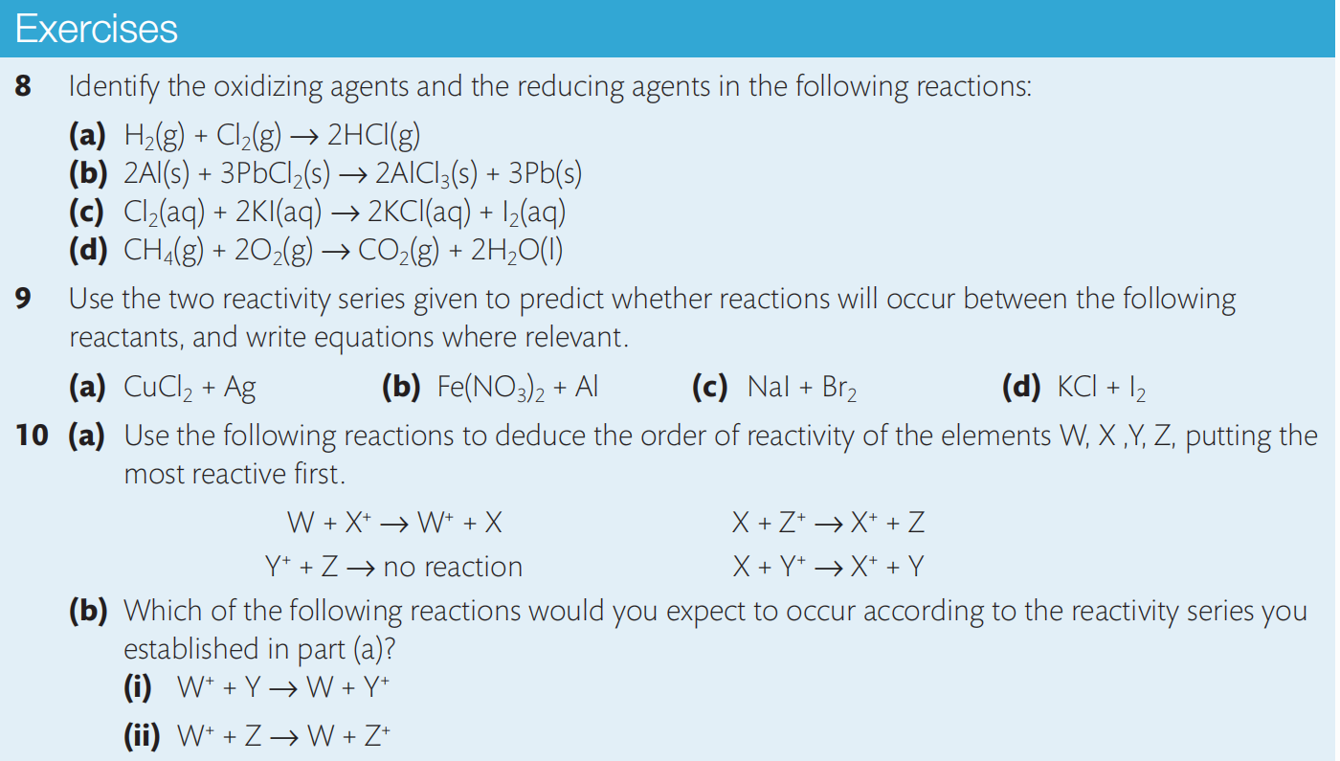

Slide 51
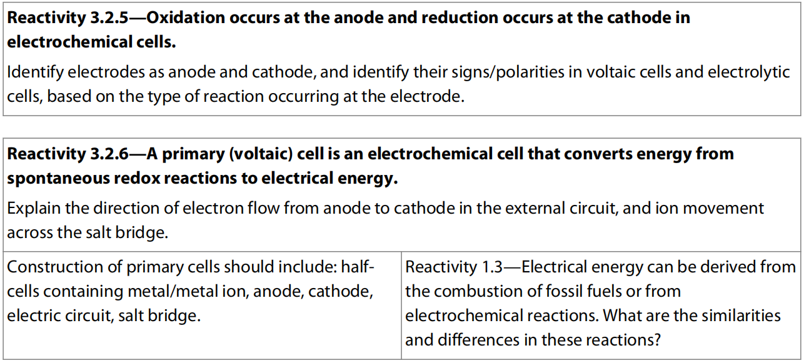
12.2 Primary cell

Slide 52
Primary Cell
Primary cell (Voltaic cell) is a device for converting chemical energy into electrical energy using a spontaneous exothermic redox reaction as a source of electrical energy, and this is the basis of commercial electrochemical cells (batteries).
It is really just a case of separating the two half-reactions:
into so-called half-cells, and allowing the electrons to flow between them only through an external circuit.

Slide 53
Half-cells generate electrode potentials
There are many types of half-cell but probably the simplest is made by putting a strip of metal into a solution of its ions.

Slide 54
In the zinc half-cell, zinc atoms will form ions by releasing electrons that will make the surface of the metal negatively charged with respect to the solution.

Slide 55
There will therefore be a charge separation, known as an electrode potential, between the metal and its ions in solution.
At the same time, ions in the solution gain electrons to form Zn atoms, so an equilibrium exists as follows:
The position of this equilibrium determines the size of the electrode potential in the half-cell, and depends on the reactivity of the metal.
Different half-cells surely have different electrode potentials.

Slide 56
Two connected half-cells make a primary cell
If we now connect these two half-cells by an external wire, electrons will have a tendency to flow spontaneously from the zinc half-cell to the copper half-cell because of their different electrode potentials.
The half-cells connected in this way are often called electrodes, and their name gives us information about the type of reaction that occurs there.

Slide 57
The electrode where oxidation occurs is called the anode, in this case it is the zinc electrode and it has a negative charge:
Zn (s) → Zn²⁺ (aq) + 2 e–
The electrode where reduction occurs is called the cathode, in this case it is the copper electrode and it has a positive charge:
Cu²⁺ (aq) + 2 e– → Cu (s)
A potential difference will, however, only be generated between the electrodes when the circuit is complete.

Slide 58
Electricity can be produced by connecting two different metals in solutions of their metal ions.
X
e⁻
e⁻
Copper
(Cathode)
Zinc
(Anode)
Salt Bridge
Copper sulphate solution
Zinc chloride solution
Electrons flow in the wires from the metal high in the
electrochemical series to the lower metal.

Slide 59
The purpose of the “salt bridge” is to complete the circuit.
X
e⁻
e⁻
Copper
(Cathode)
Zinc
(Anode)
Salt Bridge
Copper sulphate solution
Zinc chloride solution
Ions flow through solutions and through the salt bridge.
The movement of ions through the salt bridge completes the circuit.

Slide 60
The electrodes in Primary cell
The electrode that provides electrons is called negative electrode (-).
The electrode that gains electrons is called positive electrode (+).
The electrode at which Oxidation (loss of electrons) takes places is the Anode; (O,A, vowels)
And the electrode at which Reduction (gain of electrons) takes place is the Cathode. (R,C, consonants)
So in this case, Zinc is the anode (-) and copper is the cathode (+) of this voltaic cell.

Slide 61
External electronic circuit
An external electronic circuit, connected to the metal electrode in each half-cell.
A voltmeter can also be attached to this external circuit to record the voltage generated.
Electrons will flow from the anode to the cathode through the wire.

Slide 62
Salt bridge
A salt bridge completes the circuit. The salt bridge is a glass tube or strip of absorptive paper that contains an aqueous solution of ions. Movement of these ions neutralizes any build-up of charge and maintains the potential difference.
Anions move in the salt bridge from the cathode to the anode, which opposes the flow of electrons in the external circuit.
Cations move in the salt bridge from the anode to the cathode.
The solution chosen is often aqueous NaCl or K₂SO₄ as these ions will not interfere with the reactions at the electrodes. Without a salt bridge, no voltage is generated.

Slide 63
Cell diagram convention
Rather than always drawing out all the components of a voltaic cell, a shorthand version known as a cell diagram convention (or cell notation)can be used.
This has the following features:
a single vertical line represents a phase boundary such as that between a solid electrode and an aqueous solution within a half-cell;
a double vertical line represents the salt bridge;
the aqueous solutions of each electrode are placed next to the salt bridge;
the anode is generally put on the left and the cathode on the right, so electrons flow from left to right;
spectator ions are usually omitted from the diagram;
if a half-cell includes two ions, they are separated by a comma because they are in the same phase.

Slide 65
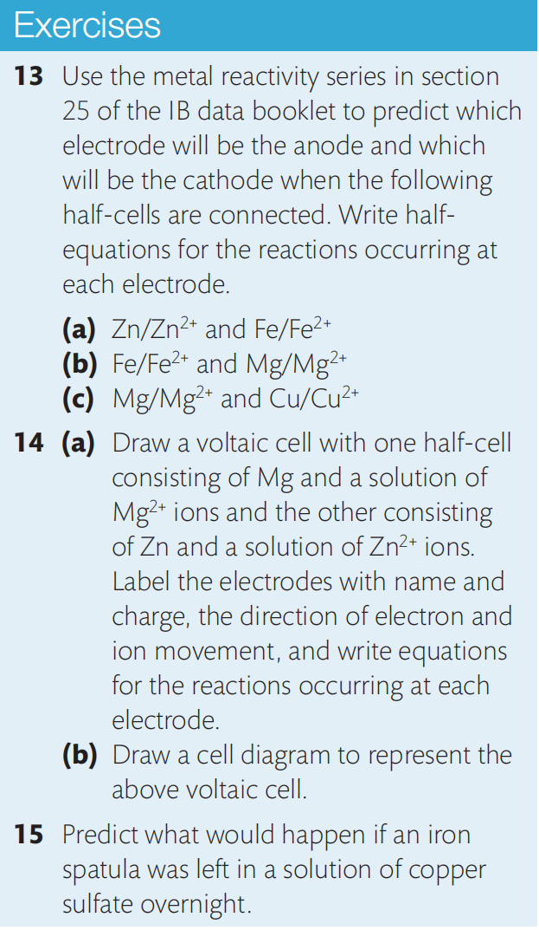

Slide 66
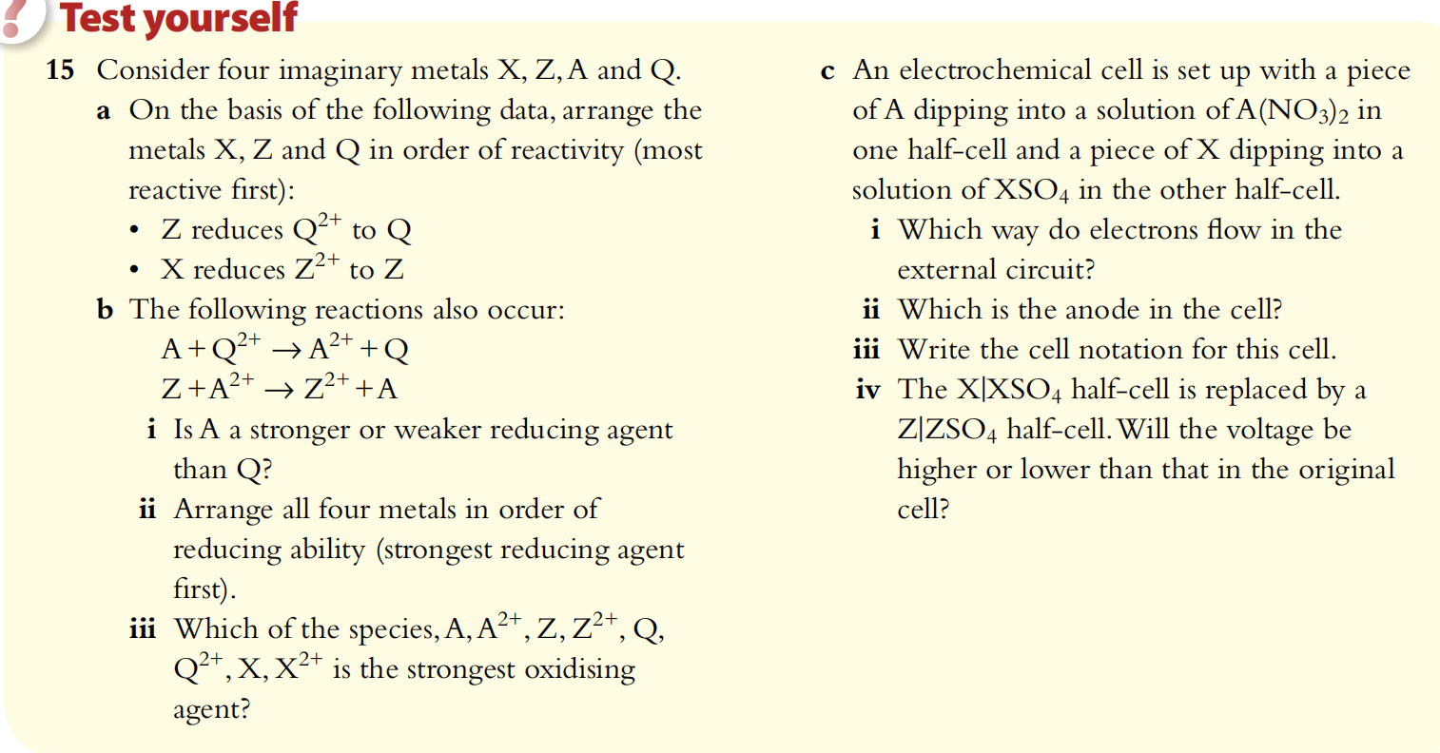

Slide 67
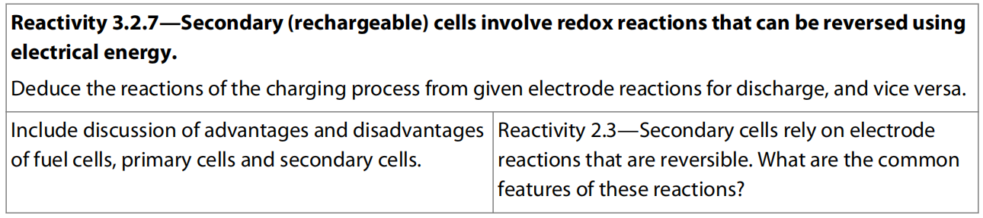
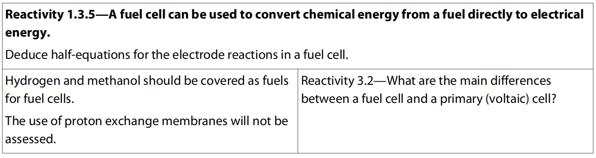
12.3 Secondary cell and Fuel Cell

Slide 68
Secondary Cell
A battery is a series of two or more electrochemical cells, typically enclosed in a single container. In a primary electrochemical cell, ultimately the reaction materials will be consumed, and the reaction is not reversible. Either the anode, the electrolyte, or both, need to be replaced, or the battery will be thrown away. Typically, the anode (negative electrode) is oxidized and can no longer be used.
The ions travelling through the solution and salt bridge can polarize the cell, which causes the chemical reaction to stop. Polarization can also cause a build-up of hydrogen bubbles on the surface of the anode. These can increase the internal resistance of the cell and reduce its electrical output.
Primary cells do not operate well under high-current demands, but are suitable for low-current household devices.

Slide 69
In a secondary cell, or a rechargeable cell, the chemical reactions that generate electricity can be reversed by applying an electric current to the cell.
Secondary cells can satisfy higher current demands than primary cells but have a higher rate of self-discharge.
For example, batteries in cell phones are made of secondary cells that can be recharged using electrical energy. When you purchase a replacement battery for a phone, you need to charge it before use because it will have self-discharged during the storage and transportation.

Slide 70
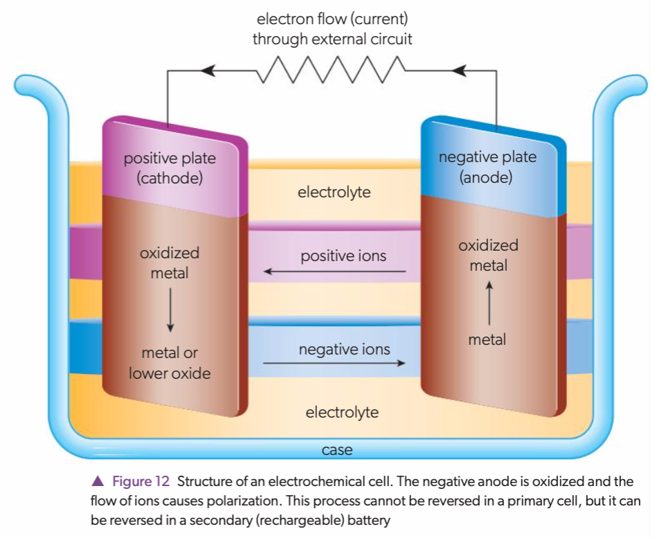

Slide 71
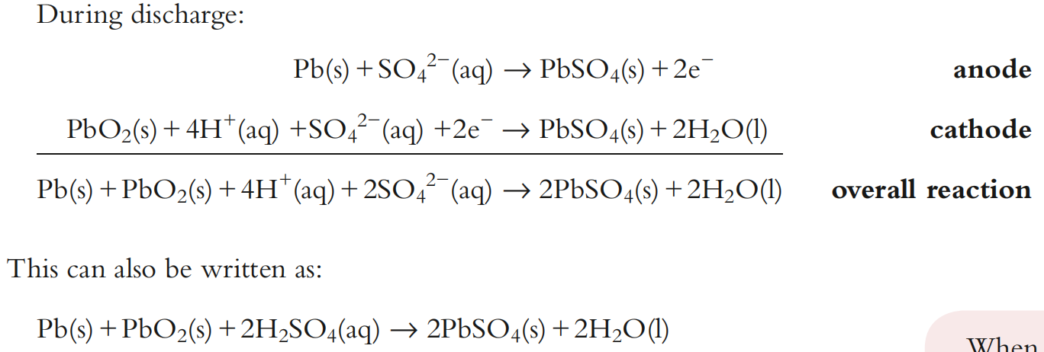
Lead-acid Battery
One of the oldest forms of rechargeable cell is the lead–acid battery, still used in the majority of car engines. The lead–acid battery consists of lead anodes and cathodes made from lead covered with a layer of lead(IV) oxide (PbO₂) in a concentrated sulfuric acid electrolyte.
A typical car battery is made up of six electrical cells in series and provides a potential difference of about 12 V. As the battery discharges, lead at the anode is oxidised, releasing electrons, while the lead(IV) oxide at the cathode is reduced. The product of both reactions is solid lead(II) sulfate, which accumulates on the electrodes within the battery.

Slide 72
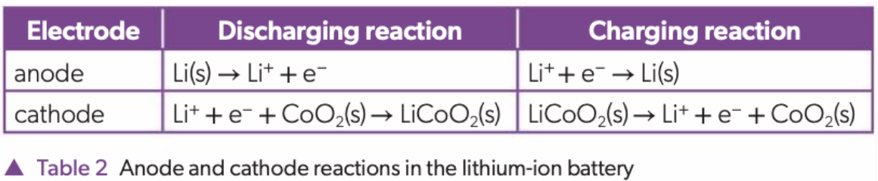
Lithium-ion Battery
Lithium-ion rechargeable batteries use lithium atoms embedded in a lattice of graphite electrodes, rather than pure lithium metal for the anode. The cathode is a lithium–cobalt oxide complex, LiCoO2. The lithium atoms are oxidized to lithium ions during discharge.
During charging, the opposite process occurs: the lithium ions in the complex migrate through the battery medium to the anode, where they accept electrons and are reduced to lithium atoms. These atoms become embedded in the graphite lattice. The battery medium must be completely non-aqueous, usually a polymer gel, as lithium reacts vigorously with water. Table 2 summarizes these reactions:
The overall cell reaction during discharge is: Li(s) + CoO₂(s) → LiCoO₂(s).

Slide 73
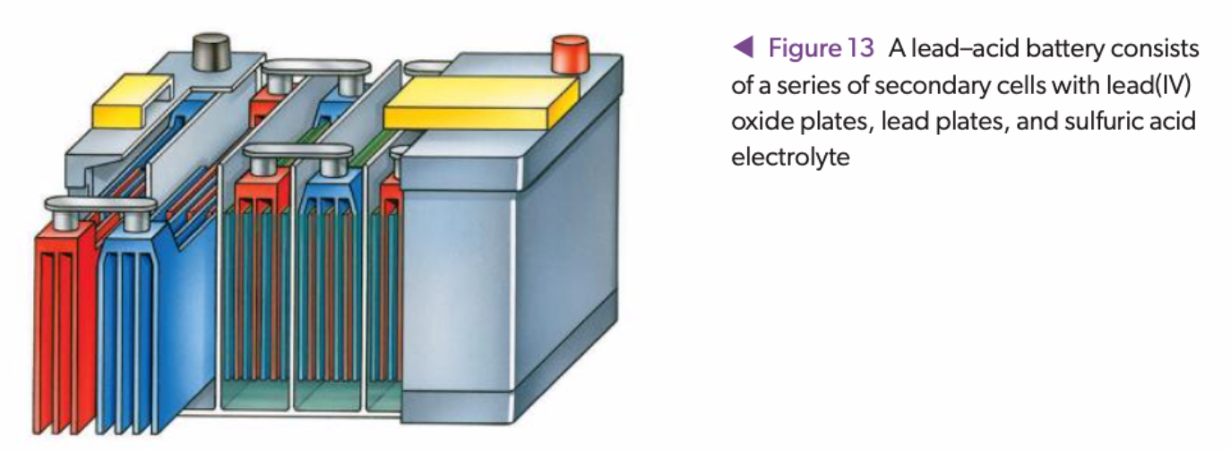
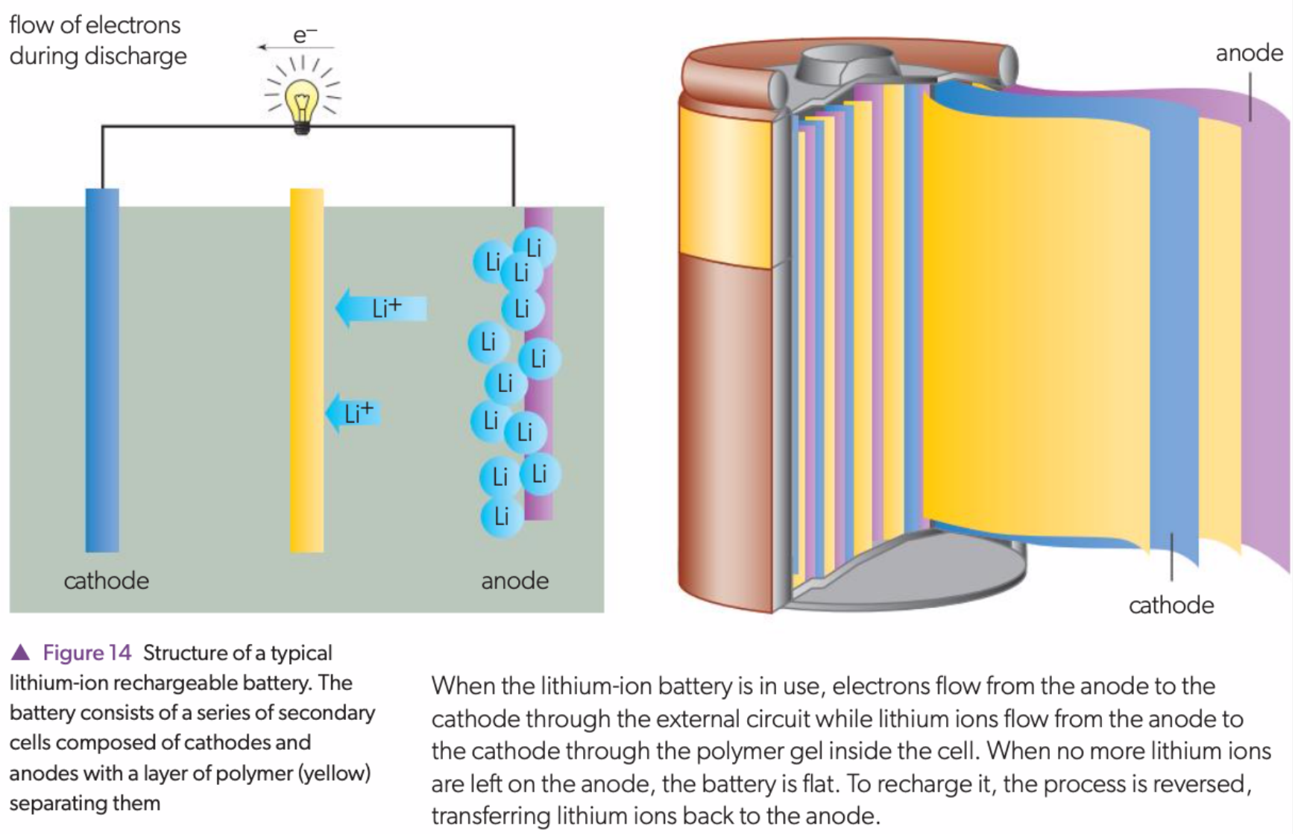

Slide 74
Fuel Cells
Fuel cells are a type of electrochemical cell that convert hydrogen, methanol, or ethanol and oxygen into water, carbon dioxide and heat.
They cause little pollution and are very efficient.
Like primary cells, they are not rechargeable, but unlike primary cells, they require a steady supply of fuel and oxygen, so the reactions in the cell can continue indefinitely.
A typical fuel cell has the following key components:
Electrolyte or separator: this keeps componentsfrom mixing. For example, a proton exchange membrane (PEM) is a polymer that allows H⁺ ions to diffuse through but preventsthe diffusion of other ions, electrons or molecules.
Electrodes: The electrodes are made of a catalyst that allows for the chemical reactions to occur. There is an oxidizing electrode (anode) and reducing electrode (cathode).
Bipolar plate: This conducts the electrical current from cell to cell and ensures uniform distribution of the fuel gas.

Slide 75
For example, in a hydrogen fuel cell, hydrogen gas is supplied to the anode while oxygen gas is supplied to the cathode. The following reactions occur in a hydrogen fuel cell:
anode: H₂(g) → 2 H⁺(aq) + 2 e⁻
cathode: O₂(g) + 4 H⁺(aq) + 4 e⁻ → 2 H₂O(l)
overall cell equation: 2 H₂(g) + O₂(g) → 2 H₂O(l)
In a direct methanol fuel cell (DMFC), methanol is supplied to the anode. The following reactions occur in a DMFC:
anode: CH₃OH(l) + H₂O(l)→ CO₂(g) + 6 H⁺ (aq) + 6 e⁻
cathode: 3/2 O₂(g) + 6 H⁺(aq) + 6 e⁻ → 3 H₂O(l)
overall cell equation: CH₃OH(l) + 3/2 O₂(g) → CO₂(g) + 2 H₂O(l)

Slide 76
Hydrogen fuel cells use hydrogen gas as the fuel. These cells do not produce greenhouse gases. The heat formed in the exothermic reaction 2 H₂(g) + O₂(g) → 2 H₂O(l) can be utilized, increasing the efficiency of the cell. The oxygen gas can be obtained from the air.
The catalysts used for the electrodes are often made of platinum or other expensive metals, which makes fuel cells expensive to run on a commercial scale. The hydrogen gas used must be very pure to prevent the poisoning of the catalyst and therefore the reduction of the cell electrical output.
There are two main sources of hydrogen gas:
Clean hydrogen can be produced by the electrolysis of water. Solar cells or wind generators provide the cleanest form of energy for powering the electrolysis.
Hydrogen gas can also be obtained by the reaction of hydrocarbons, especially methane, with steam: CH₄(g) + H₂O(g) → 3 H₂(g) + CO(g)
DMFCs have the advantage of not needing to extract hydrogen gas because they use methanol as the fuel. However, they produce carbon dioxide, CO₂(g), which is a greenhouse gas.

Slide 77
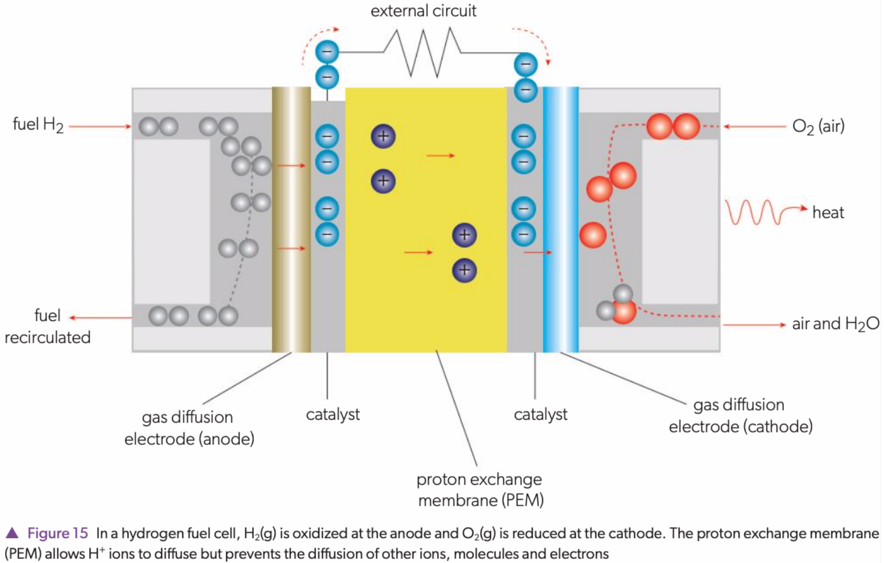

Slide 78
Similarities between fuel cells and rechargeable batteries
They both generate electrical energy from chemical energy.
They are both composed of an anode, a cathode and an electrolyte.
They both generate a current based on the separation of reduction and oxidation reactions and the flow of electrons through an external circuit.

Slide 79
Differences between fuel cells and rechargeable batteries
Fuel cells require an external source of chemical energy (fuel), but rechargeable batteries have their chemical energy source within them.
Fuel cells never run out so long as there is a constant supply of fuel from an external source; rechargeable batteries run out and then have to be recharged by connecting to an electricity supply which reverses the reactions.
Rechargeable batteries are far cheaper than fuel cells.
Fuel cells are capable of generating a far greater quantity of electricity than rechargeable batteries because the fuel is supplied constantly.
Fuel cells are non-polluting – hydrogen fuel cells produce water as the only product; rechargeable batteries may contain toxic metals (Cd, Pb) so are difficult to dispose of.
Fuel cells can produce drinkable water as a byproduct; there is no byproduct of rechargeable batteries.
Rechargeable batteries can only be recharged so many times – they have a finite life and must be replaced eventually; fuel cells have much better longevity.

Slide 80
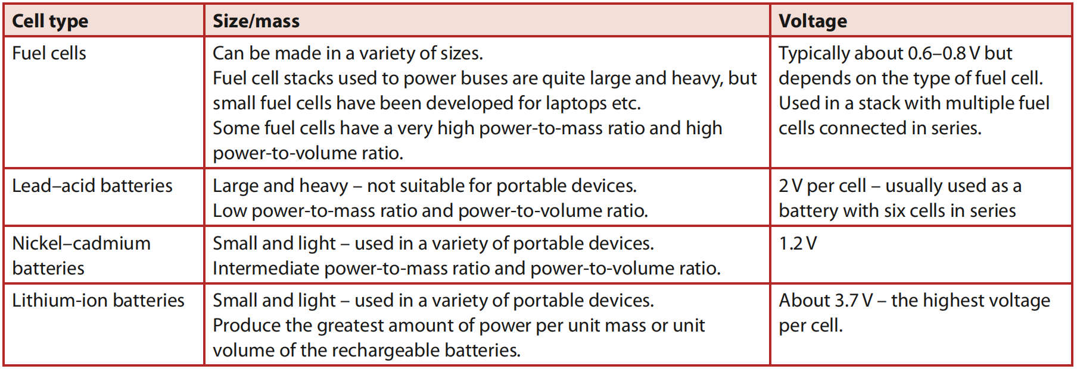

Slide 81
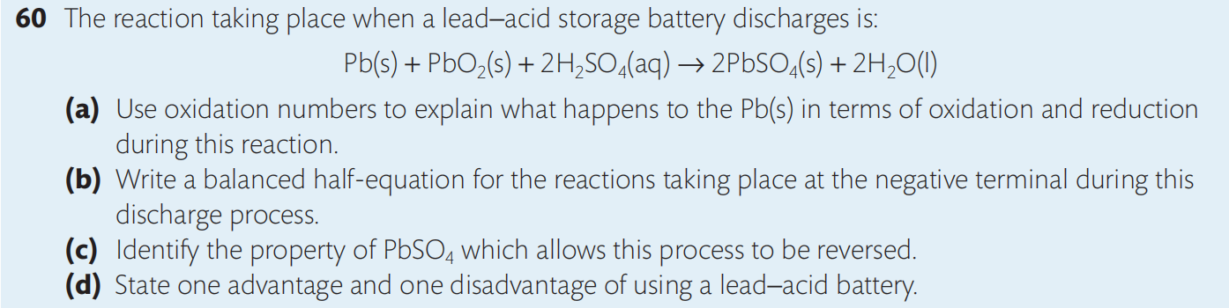
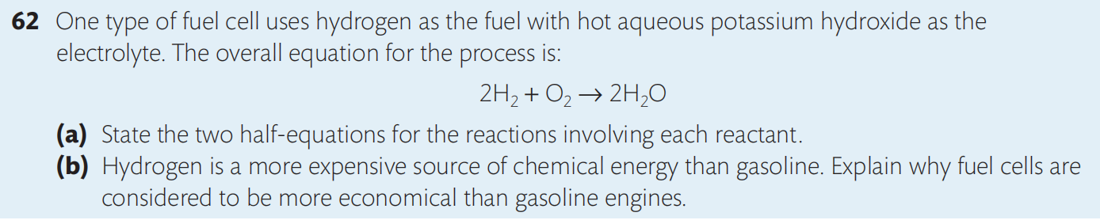
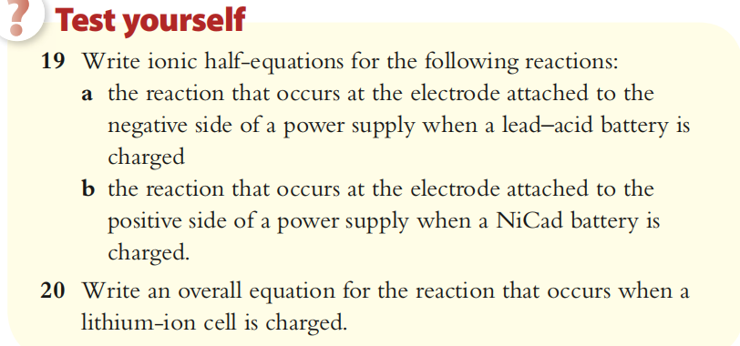

Slide 82
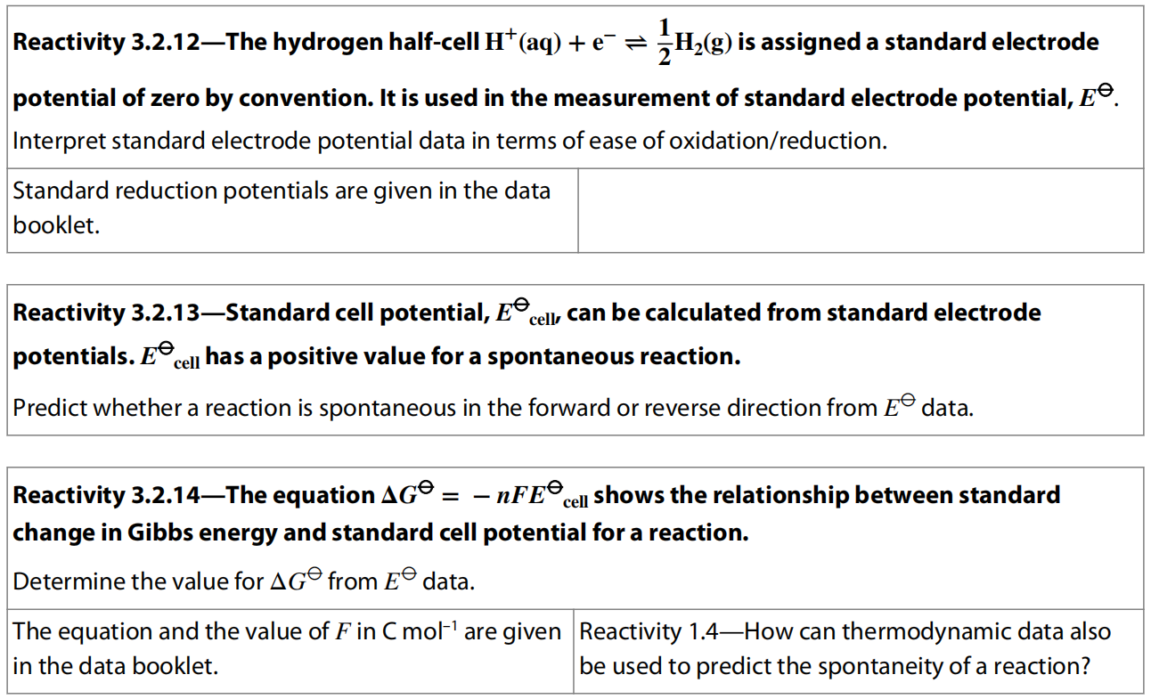
12.4 Application of Primary Cell (Higher Level)

Slide 83
Different half-cells make primary cells with different voltages
Any two half-cells can be connected together similarly to make a voltaic cell.
For any such cell the direction of electron flow and the voltage generated will be determined by the difference in reducing strength of the two metals.
In most cases this can be judged by the relative position of the metals in the reactivity series.
For example if we changed the copper half-cell in the example above to a silver half-cell, a larger voltage would be produced because the difference in electrode potentials of zinc and silver is greater than between that of zinc and copper.
Electrons would flow from zinc (anode) to silver (cathode).

Slide 85
If we now make a voltaic cell with one copper electrode and one silver electrode, the direction of electron flow would be away from copper towards silver.
In other words, copper will be the anode and silver the cathode.
This is due to the greater reducing power of copper – it has the lower electrode potential.

Slide 86
We can now summarize the parts of a voltaic cell and the direction of movement of electrons and ions:
electrons flow from anode to cathode through the external circuit;
anions migrate from cathode to anode through the salt bridge;
cations migrate from anode to cathode through the salt bridge.

Slide 88
Standard electrode potentials
Some definitions of terms used in electrochemistry and an introduction to the units used.
The SI unit of electric current (I) is the ampere, usually known as amp (A). It is an SI base unit, from which other units are derived.
The SI unit of electric charge (Q) is the coulomb (C). It is the amount of charge transported in 1 second by a current of 1 ampere. The charge on a single electron is 1.602 × 10^{–19} C, so one mole of electrons carries a charge of 96485.34 C mol^{–1}, and this is known as faraday’s constant (F).
So the familiar equation Q = I × t can also be written as C = A × s
The charge on a single electron is 1.602 × 10^{–19} C, so 1 mol of electrons carries a charge of 96 485.34 C mol^{–1}.

Slide 89
The SI unit of potential difference is the volt (V). It is equal to the difference in electric potential between two points on a conducting wire, and defined as the amount of energy (J) that can be delivered by a coulomb of electric charge (C).
V = J × C^{–1}
The electromotive force (EMF) of a cell is the greatest potential difference that it can generate. It is measured in volts. In practice, because of its internal resistance, it is measurable only when the cell is not supplying current.
We will use the term cell potential E_{cell} to describe the potential difference when generating electrical energy.
Cells in series are connected along the same path, so the same current flows through all components.

Slide 90
Comparisons of half-cell electrode potentials need a reference point
A voltaic cell generates a potential difference known as the electromotive force (EMF).
As electrons tend to flow from the half-cell with the more negative potential to the half-cell with the more positive potential, the potential generated is called the cell potential or electrode potential and is given the symbol E.

Slide 91
The magnitude of this voltage depends on the difference in the tendencies of these two half-cells to undergo reduction.
Clearly, the electrode potential of a single half-cell cannot be measured in isolation, but only when electrons flow as it is linked in this way to another half-cell.
Therefore, in order to draw up a list of the relative reducing power of different half cells, it is necessary to compare them all with some fixed reference point that acts as a standard for measurement.
It is similar to the way in which heights of mountains can be compared with each other because each is given a height relative to an agreed zero point, in this case sea level.

Slide 92
The Standard Hydrogen Electrode
In electrochemistry, the reference standard is the standard hydrogen electrode, sometimes known as SHE.
As we will see, this gives us a baseline for measuring and comparing the electrode potentials of other half-cells.

Slide 93
Platinum is used as the conducting metal in the electrode because it is fairly inert and will not ionize, and it also acts as a catalyst for the reaction of proton reduction.
It is used in the form of ‘platinized platinum’, which means the surface of the metal is coated with very finely divided platinum (sometime known as platinum black).
This causes the electrode reaction to happen rapidly as the large surface area helps in the adsorption of hydrogen gas.
Note that the concentration of H⁺ (aq) is 1.0 mol dm^{–3} (pH = 0) and the pressure of H₂ (g) is 100 kPa at 298 K.

Slide 94
As the electrode is immersed in the acidic solution, it is alternately bathed in H⁺ (aq) and H₂ (g), setting up an equilibrium between the adsorbed layer of H₂ (g) and aqueous H⁺ ions.
2 H⁺ (aq) + 2 e– H₂ (g)
The reaction is reversible, occurring as reduction of H⁺ (forward reaction) or as oxidation of H₂ (backward reaction), depending on the electrode potential of the half cell to which it is linked, as we will see below.
The hydrogen half-cell is arbitrarily assigned an electrode potential of zero volts, 0 V.
This gives us a means to measure and compare electrode potentials of any other half cell to which it is connected.

Slide 95
Measuring standard electrode potentials
As electrode potentials depend on the concentrations of ions, gas pressures, purity of substance, and temperature, these must all be controlled in order to make valid comparisons between different half-cells. So standard conditions are used in these measurements, defined as follows:
all solutions must have a concentration of 1.0 mol dm^{–3};
all gases must be at a pressure of 100 kPa;
all substances used must be pure;
temperature is 298 K;
if the half-cell does not include a solid metal, platinum is used as the electrode.
Half-cells under these conditions are known as standard half-cells.

Slide 97
When the standard hydrogen electrode is connected to another standard half-cell by an external circuit with a high-resistance voltmeter and a salt bridge, the EMF generated is known as the standard electrode potential of that half-cell.
It is given the symbol Eº (E refers to electrode potential and the superscript º refers to standard conditions).

Slide 99
For example, as shown in previous picture, Eº for the Cu²⁺ (aq)/Cu (s) half-cell is + 0.34 V.
The positive value for Eº indicates that this half-cell has a greater tendency to be reduced than H⁺.
So electrons tend to flow from the hydrogen half-cell, which is therefore oxidized, to the copper half-cell, which is reduced.
The hydrogen half-cell is the anode and the copper half-cell is the cathode, defined by the processes that occur there.
The overall reaction is therefore:

Slide 100
|

Slide 102
Standard electrode potentials are given for the reduction reaction
Given that half-cell reactions exist as equilibria and can occur as oxidation or as reduction, for purposes of standardizing the data there has to be an agreed convention.
The standard electrode potential is always given for the reduction reaction, in other words for the reaction with the oxidized species on the left and the reduced species on the right.
For this reason, standard electrode potential values, Eº, are sometimes known as standard reduction potentials.

Slide 103
Standard electrode potentials at 298 K
2H⁺

Slide 104
The following points should be noted:
all Eº values refer to the reduction reaction;
the Eº values do not depend on the total number of electrons, so cannot be scaled up or down according to the stoichiometry of the equation;
the more positive the Eº value for a half-cell, the more readily it is reduced.

Slide 105
Using standard electrode potential data
The fact that standard electrode potential data are all referenced to the same point (SHE) provides a relative scale for us to make predictions about redox reactions and the direction of electron flow.
We will look at three specific applications of using Eº data here.

Slide 106
1. Calculating the cell potential, Eº_{cell}
From the Eº values for any two half-cells, we can calculate the EMF for a voltaic cell in which they are connected.
By deducing the direction of electron flow, we can also predict the outcome of a redox reaction.
The half-cell with the higher Eº value will be reduced, and the half-cell with the lower Eº value will be oxidized.
As the cell potential is the difference in the tendencies of these two half-cells to be reduced, we can calculate it by substituting the appropriate values into the following expression:

Slide 107
Note the following:
The Eº values used in this expression must be the reduction potentials as supplied in data tables. Do not invert them before substituting into the equation!
The Eº values do not have to be multiplied according to the stoichiometry of the redox equation. This is because they are intensive quantities and do not depend on the total number of electrons shown in the equation.

Slide 110
Pt (s) | Mn²⁺ (aq), MnO₄⁻ (aq), H⁺ (aq) || IO₄⁻ (aq), IO₃⁻ (aq), H⁺ (aq) | Pt (s)

Slide 111
2. Determining spontaneity of a reaction
As Eº values can be used to predict the redox change that will occur among a mixture of reactants, it follows we can use them to determine whether a particular reaction will occur spontaneously. This is based on the fact that a voltaic cell will always run in the direction that gives a positive value for the Eº cell.
If Eº cell is positive, the reaction is spontaneous as written.
If Eº cell is negative, the reaction is non-spontaneous, and the reverse reaction is spontaneous.

Slide 114
Electrode potential and free energy change (E_{cell} and ΔG)
We have now come across two quantitative measures of the spontaneity of a reaction, Eº_{cell} and the free energy, ΔGº.
These two values are directly related through the equation:
n = number of moles of electrons transferred per mol of reaction;
F = the charge carried by 1 mole of electrons, known as the Faraday constant (it has a value of approximately 96 500 C mol^{–1}).
The units of the terms in this equation confirm the relationship:
ΔGº (J mol⁻¹) = –n (mol mol⁻¹) F (C mol^{–1}) Eº (V) as J = C × V

Slide 115
The negative sign in the equation indicates that E and G have opposite signs:
when Eº_{cell} is positive, ΔGº is negative, so the reaction is spontaneous;
when Eº_{cell} is negative, ΔGº is positive, so the reaction is non-spontaneous;
when Eº_{cell} is 0, ΔGº is 0, so the reaction is at equilibrium.
Because of the direct relationship between Eº_{cell} and ΔGº, the more positive the value of Eº_{cell}, the more energetically favorable is the reaction.
It also follows that a voltmeter can be considered as an indirect measure of free-energy change as well as of electrode potential.
This equation enables us to calculate the free-energy change of a reaction from standard electrode potential data.

Slide 116
= - 212000 J

Slide 117
Nernst Equation
In practice, voltaic cells rarely run under standard conditions, and in any case the concentrations change as the reaction proceeds.
A modification of the equation above, known as the Nernst equation, is used to calculate cell potentials under non-standard conditions.
The cell potential depends on:
the nature of the half cells, Eº;
the temperature T of the solution;
the reaction quotient Q, which is determined by concentration of reactants and products in aqueous solution.

Slide 118
The Nernst equation can be used to calculate the electrode potentials of half-cells or cells under non-standard conditions:
E = Eº − (RT/nF) ln Q
where
E is the electrode potential
Eº is the standard electrode potential
R is the gas constant, 8.31 J K⁻¹ mol⁻¹
T is the temperature in kelvin
n is the number of electrons transferred
F is the Faraday constant, 96 500 C mol⁻¹
Q is the reaction quotient

Slide 122
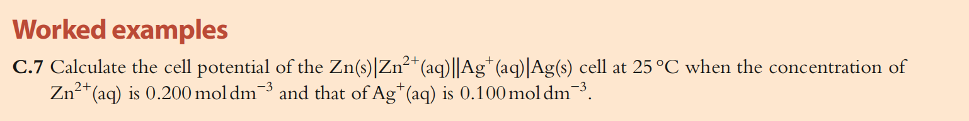
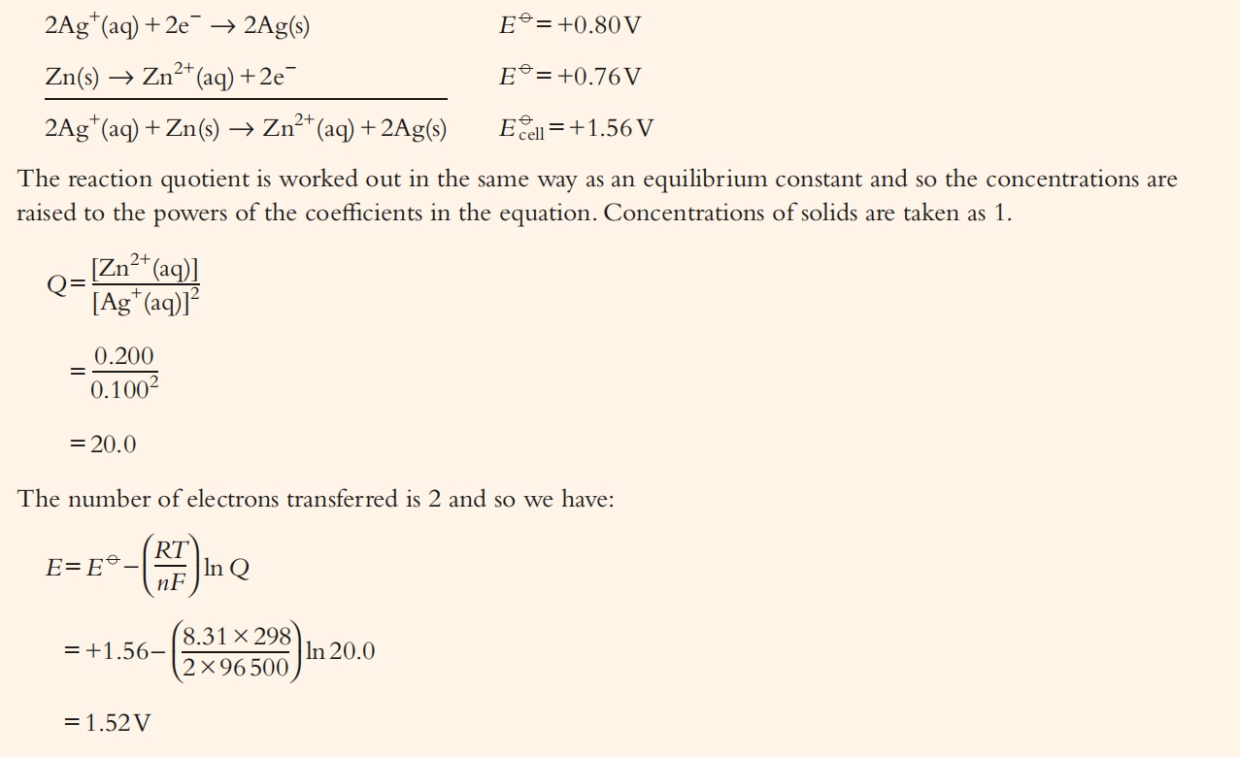

Slide 123
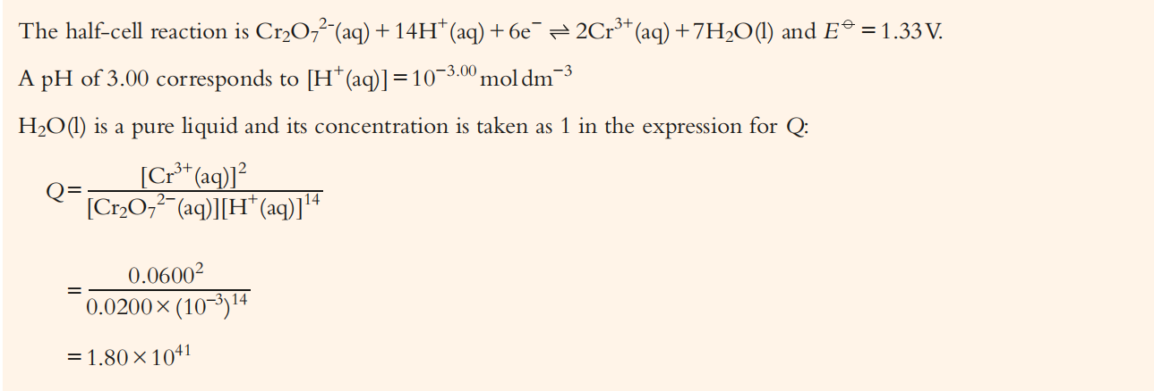
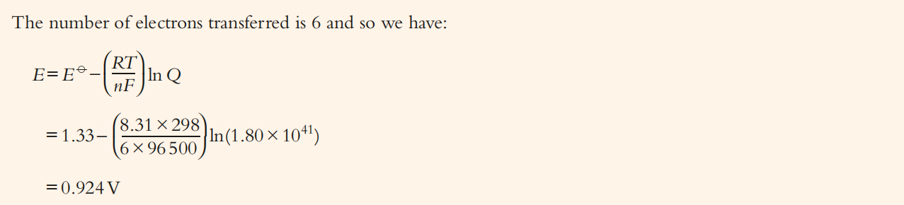

Slide 124
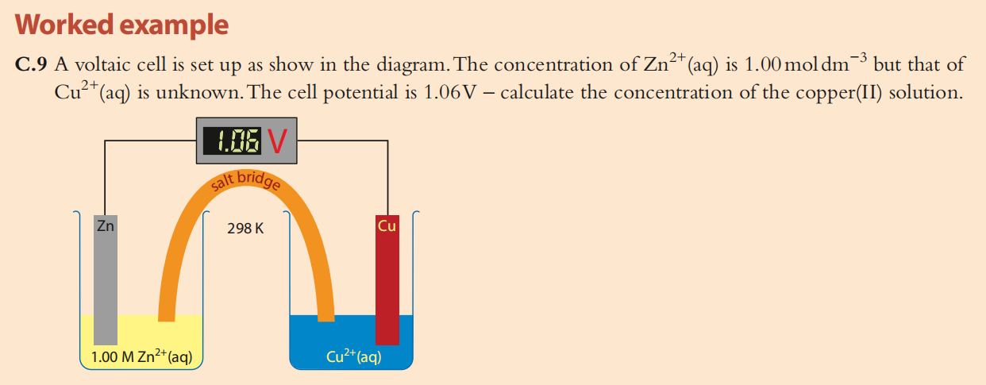

Slide 125
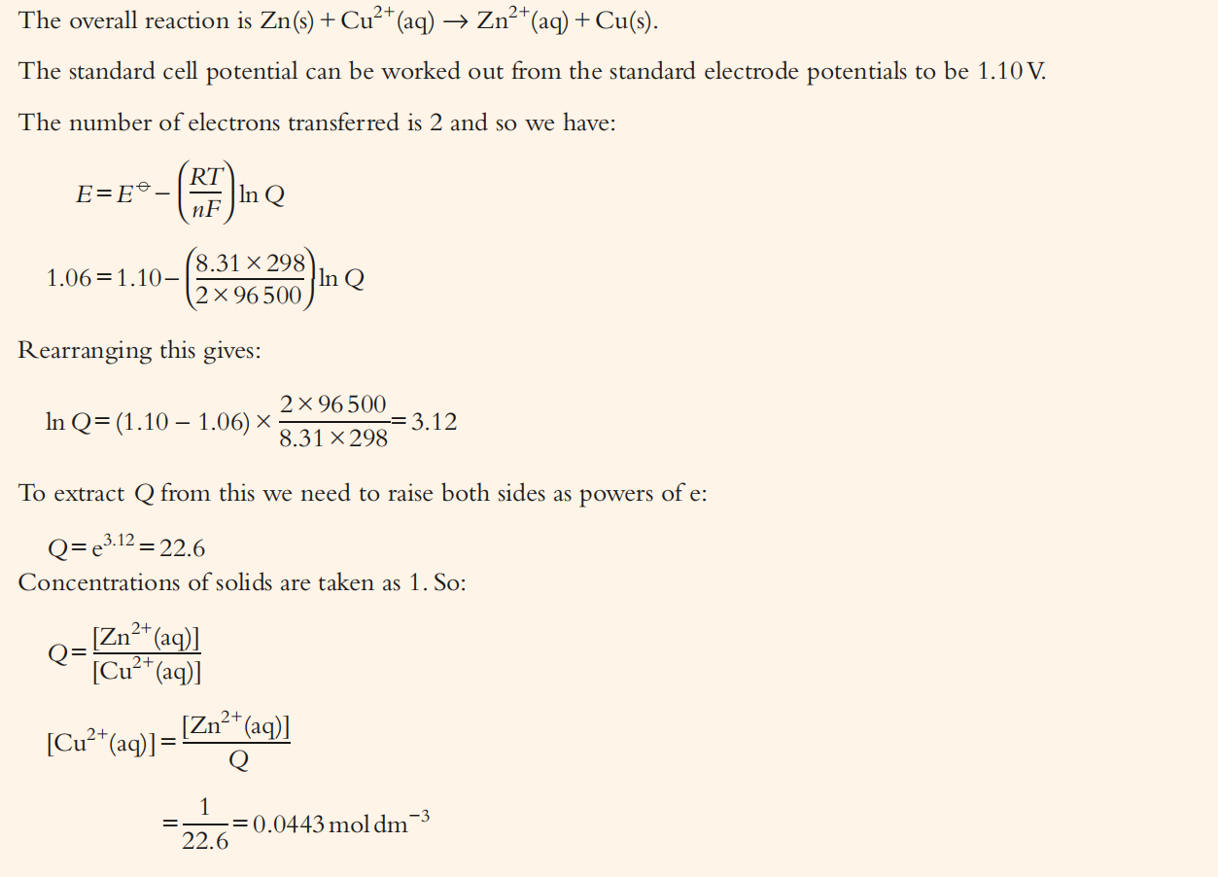

Slide 126
3. Comparing relative oxidizing and reducing power of half-cells
The calculations using Eº values for half-reactions confirm the order of the activity series discussed earlier in this chapter.
In quantitative terms, we can now say that a metal is able to reduce the ions of another metal that has a higher Eº value.
Metals with low Eº values (most negative) are therefore the strongest reducing agents.
Likewise, a non-metal is able to oxidize the ions of another non-metal that has a lower Eº value.
Non-metals with high Eº values are therefore the strongest oxidizing agents.

Slide 127
Standard electrode potentials at 298 K
2H⁺

Slide 129
Caution about interpreting E^{θ} data
Note that although Eº data give information on the energetic feasibility of a reaction and the products of a redox reaction, they do not give any information on the rate.
So a reaction that is predicted to be spontaneous may give no observable sign of reaction because the activation energy may be too high for the reaction to occur at an appreciable rate.

Slide 130
In addition, the Eº values that we have used throughout these examples relate only to standard conditions, and any changes in temperature, concentration, or pressure will alter the values, possibly even changing whether a reaction is spontaneous or not.
In summary, the interpretation of electrode potential data involves recognizing one fundamental fact: electrons always tend to flow towards the half-cell with the highest Eº value.
All other deductions and interpretations follow from this.

Slide 131
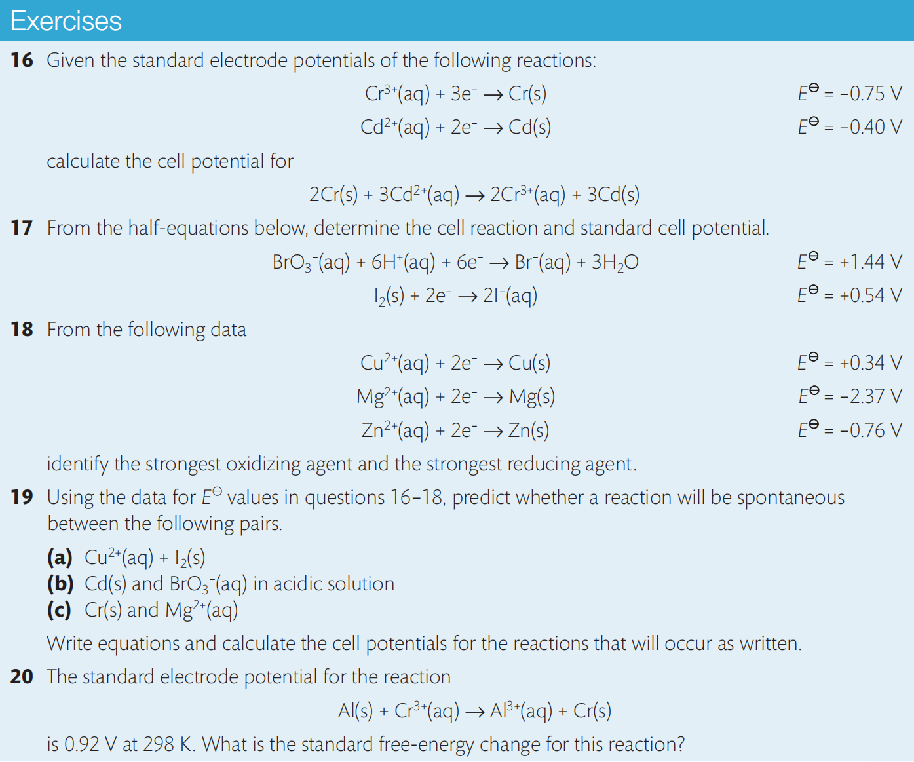

Slide 132
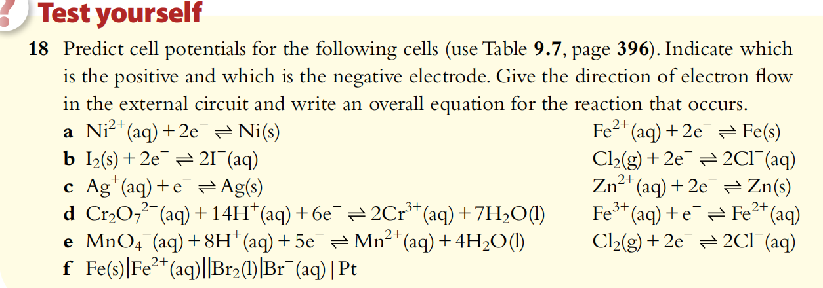
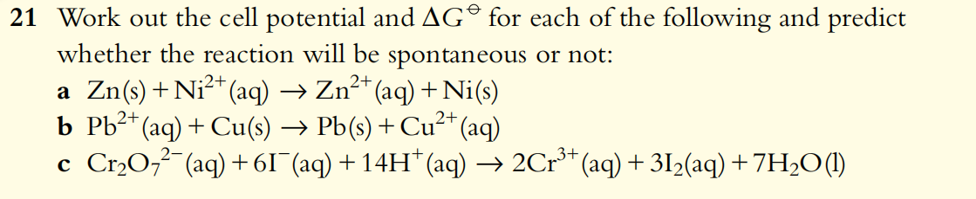

Slide 133
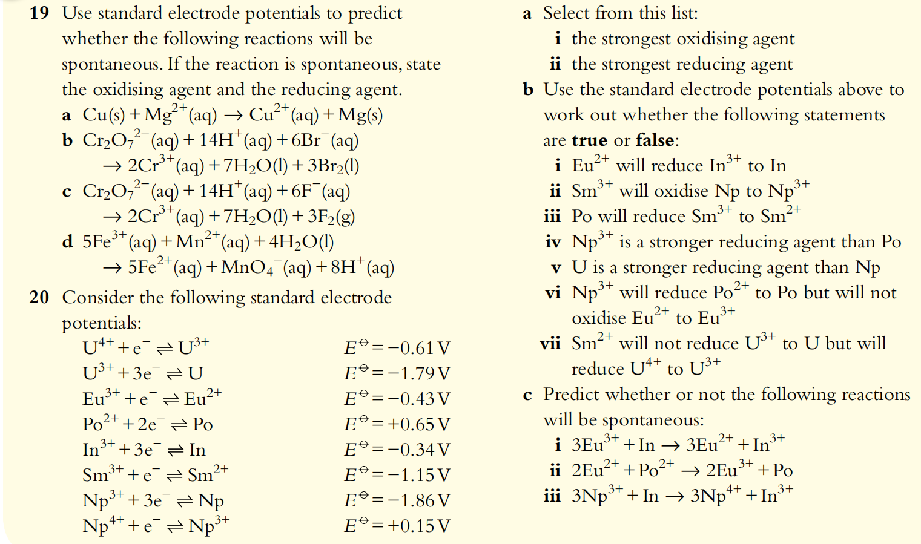

Slide 134
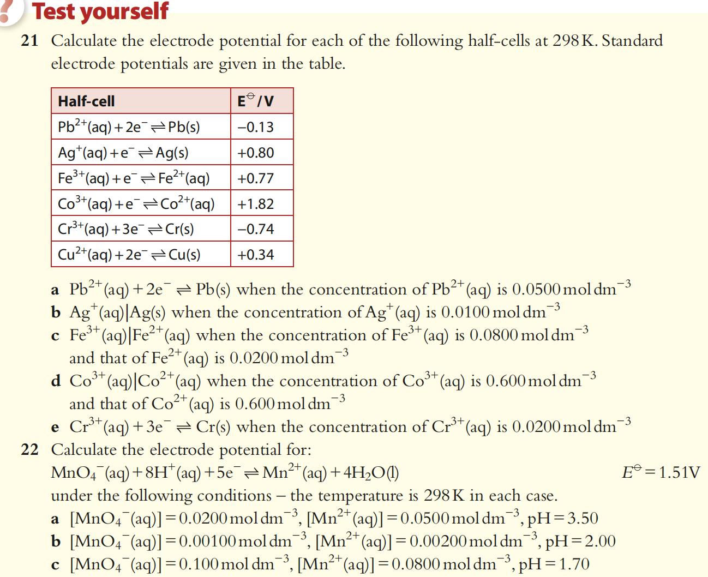

Slide 135
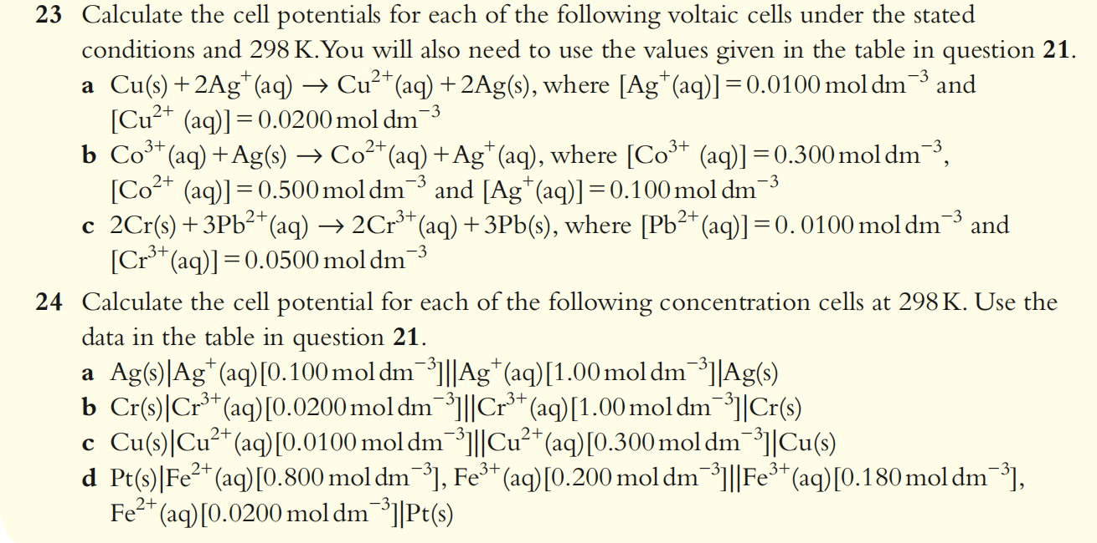

Slide 136
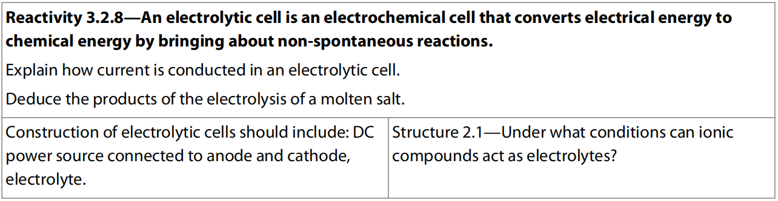
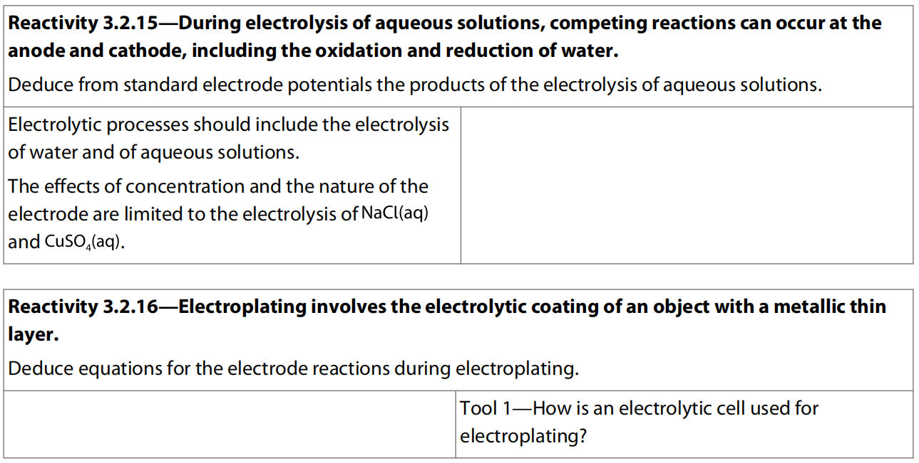
12.5 Electrolytic cell
HL Only
HL Only

Slide 137
An external source of electricity drives non-spontaneous redox reactions
As we have learnt, a voltaic cell takes the energy of a spontaneous redox reaction and harnesses it to generate electrical energy.
Reversely, an electrolytic cell uses an external source 0f electrical energy to bring about a redox reaction that would otherwise be nonspontaneous.

Slide 138
The reactant in the process of electrolysis is present in the electrolyte.
This is a liquid, usually a molten ionic compound or a solution of an ionic compound.
As the electric current passes through the electrolyte, redox reactions occur at the electrodes, removing the charges on the ions and forming products that are electrically neutral.
The ions are therefore said to be discharged during this process.

Slide 139
Reactive metals, including aluminium, lithium, magnesium, sodium, and potassium, are found naturally in compounds such as Al₂O₃ and NaCl where they exist as positive ions.
Extraction of the metal therefore involves reduction of these ions.
But this is a problem because the E^{θ} values of these reactive metal ions are so low that there are no good reducing agents available to do this.

Slide 140
In these cases, the only effective source of reduction is directly with electrons, using electrolysis.
This means that electrolysis is the only means of extracting these metals from their ores.
It is also the process used in the production of many non-metal elements of industrial importance, and in the related procedures of electroplating and anodization.

Slide 141
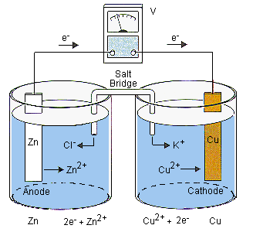
Voltaic cell

Slide 142
Electrolytic cell

Slide 143
The source of electric power is a battery or a DC power source.
This is shown in diagrams as where the longer line represents the positive terminal and the shorter line the negative terminal.
The electrodes are immersed in the electrolyte and connected to the power supply. They must not touch each other!
Electrodes are made from a conducting substance – generally a metal or graphite.
They are described as inert when they do not take part in the redox reactions.
Electric wires connect the electrodes to the power supply.

Slide 144
The electrodes in electrolytic cell
The electrode at which Oxidation takes places is called Anode; (O,A, vowels)
And the electrode at which Reduction takes place is called the Cathode. (R,C, consonants)
So: the electrode that links to the positive electrode (+) (so as to provide electrons to the positive electrode of the power) of the power is called positive electrode (+), which is anode.
The electrode that links to the negative electrode (-) (so as to gain electrons from anode of the power) of the power is called negative electrode (-), which is cathode.

Slide 146
Determining the products in electrolytic cells

Slide 148
The electrolysis of molten salts
When the electrolyte is a molten salt, the only ions present are those from the compound itself as there is no solvent.
So, usually, only one ion migrates to each electrode, and it is straightforward to predict the reactions that will occur.

Slide 150
2 Br⁻ (l) → Br₂ (g) + 2e⁻
Pb²⁺ (l) + 2 Br⁻ (l) → Pb (l) + Br₂ (g)
gas

Slide 151
Most ionic compounds have very high melting points, so electrolysis of their molten salts involves working at high temperatures, which can only be generated and maintained under industrial conditions.
Sometimes in industrial processes another compound is added to lower the melting point to make it more economical.

Slide 152
Electrolysis of molten NaCl
For example, the electrolysis of molten sodium chloride used in the extraction of sodium uses an electrolyte of molten sodium chloride to which some molten calcium chloride has been added.
This has a melting point of about 580°C, considerably lower than the 801°C for pure NaCl.
It is important though that the presence of the added CaCl₂ does not interfere with the discharge of sodium at the cathode.

Slide 153
We can check that this is the case by looking at the E^{θ} values for the two metal ions.
From its higher E^{θ} value, we can deduce that Na⁺ will be reduced in preference to Ca²⁺, so the addition of CaCl₂ will not interfere with the production of Na at the cathode.

Slide 155
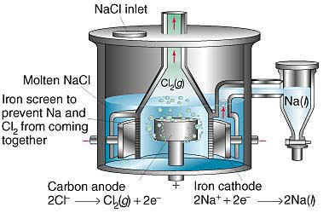
Downs Cell
Electrolysis of a molten electrolyte is often used to obtain reactive metals from their ores. (e.g. Lithium (Li), Sodium (Na), and Group 2 metals )

Slide 156
liquid

Slide 157
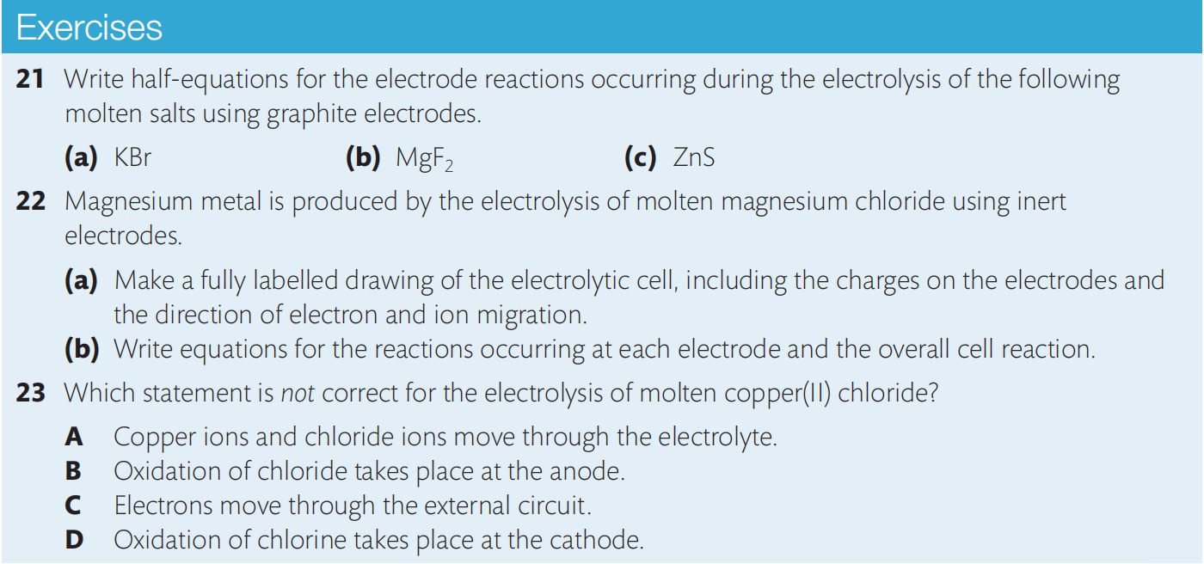
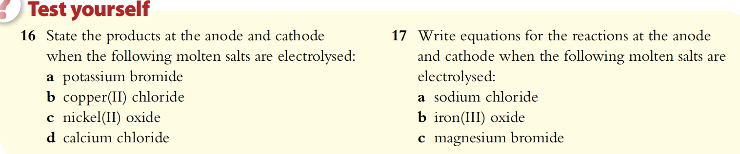

Slide 158
Electrolysis of aqueous solutions (Higher Level Only)
When electrolysis is carried out on an aqueous solution, predicting the products at the electrodes is more difficult because water itself can be oxidized or reduced.
At the cathode, H₂O can be reduced to H₂:
2 H₂O (l) + 2 e– → H₂ (g) + 2 OH– (aq)
At the anode, H₂O can be oxidized to O₂:
2 H₂O (l) → 4 H⁺ (aq) + O₂ (g) + 4 e–
So when a solute M⁺A– is in an aqueous solution, there is more than one redox reaction possible at each electrode.
Specifically:
at the anode: either A– or H₂O can be oxidized;
at the cathode: either M⁺ or H₂O can be reduced.

Slide 159
The discharge of an ion at the electrode in these cases is known as selective discharge.
The outcome is determined by the following factors:
the relative E^{θ} values of the ions;
the relative concentrations of the ions in the electrolyte;
the nature of the electrode.

Slide 160
Electrolysis of water
The ionization of pure water is extremely low, so it is not a good conductor of electricity.
However, the addition of ions increases its conductivity, so usually some ionic compound such as NaOH (which as we will see will not interfere with the discharge of the ions from water) is added when this electrolysis is performed.

Slide 163
Electrolysis of brine (NaCl (aq))
NaCl(aq) is sometimes known as brine. Electrolysis of this solution leads to the production of H₂ (g) , Cl₂ (g), and NaOH (aq), all of which are of commercial importance.

Slide 165
Cl⁻
2 OH⁻ (aq)

Slide 166
Electrolysis of CuSO₄ (aq)
CuSO₄ (aq) is a bright blue colour, due to the presence of the hydrated Cu²⁺ ion.
Electrolysis of this solution yields different products depending on the nature of the electrodes.
We will describe the reactions with (a) graphite electrodes and (b) Cu electrodes here, following the same steps according to the numbered sequence.

Slide 168
Cu²⁺

Slide 170
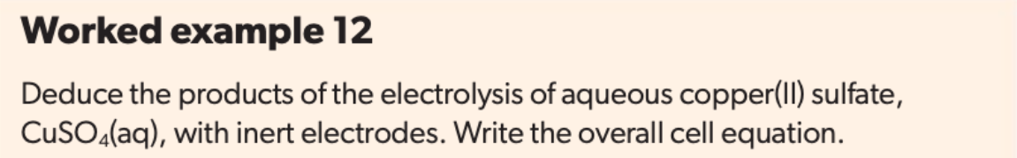
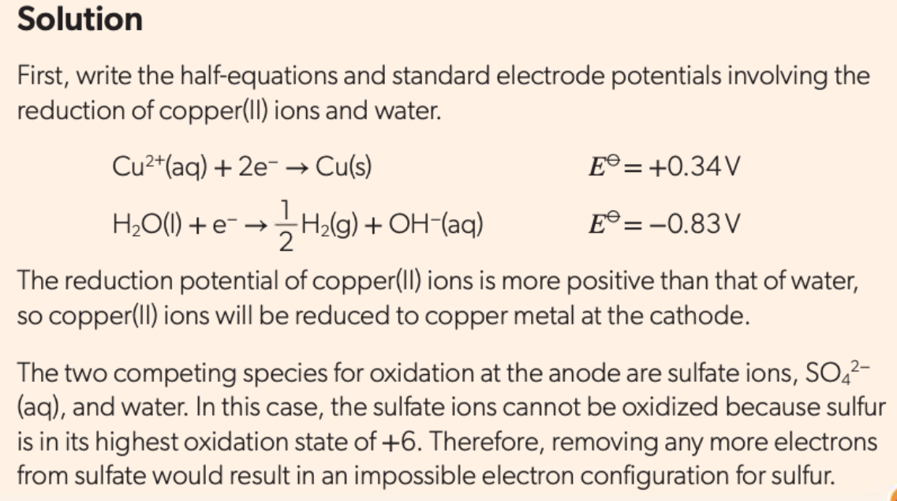
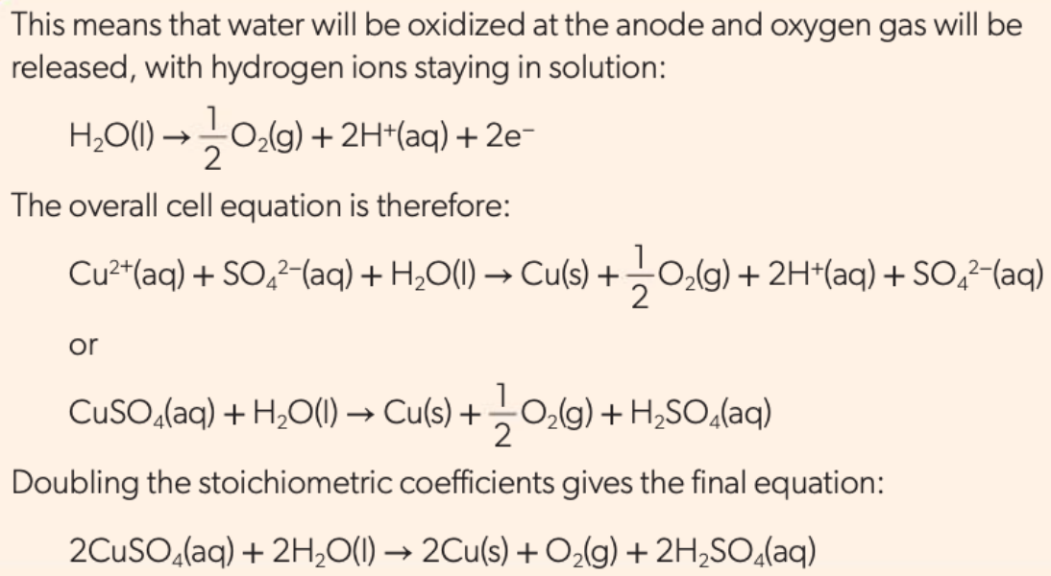

Slide 171
Electroplating (Higher Level Only)
During the electrolysis of CuSO₄ (aq), we saw that Cu(s) is deposited on the cathode when either graphite or copper electrodes are used.
This is one example of electroplating, the process of using electrolysis to deposit a layer of a metal on top of another metal or other conductive object.

Slide 172
An electrolytic cell used for electroplating has the following features:
an electrolyte containing the metal ions which are to be deposited;
the cathode made of the object to be plated;
sometimes the anode is made of the same metal which is to be coated because it may be oxidized to replenish the supply of ions in the electrolyte.

Slide 174
Reduction of the metal ions at the cathode leads to their deposition on its surface.
The process can be controlled by altering the current and the time according to how thick a layer of metal is desired.
Electroplating serves many different purposes, some of which are outlined in the next slide.

Slide 175
Purification of metals
An application of this is used in the purification of copper.
The process uses electrolysis of a solution containing Cu²⁺ (aq) with an impure copper anode and a small pure copper cathode.
As the cell runs, the anode erodes as copper is transferred to the cathode, which therefore increases in mass.
Impurities collect as sludge in the bottom of the cell.

Slide 177
Applications of electroplating
Decorative purposes. For example, covering a metal with a layer of a more expensive or decorative metal, such as silver- and nickel-plating of cutlery.
Corrosion control. For example, iron with a layer of zinc deposited on its surface, known as galvanized iron, is protected from corrosion as the zinc will be preferentially oxidized. This is sometimes called sacrificial protection.
Improvement of function. For example electroplating with chromium improves the wear on steel parts such as crankshafts and hand tools.

Slide 178
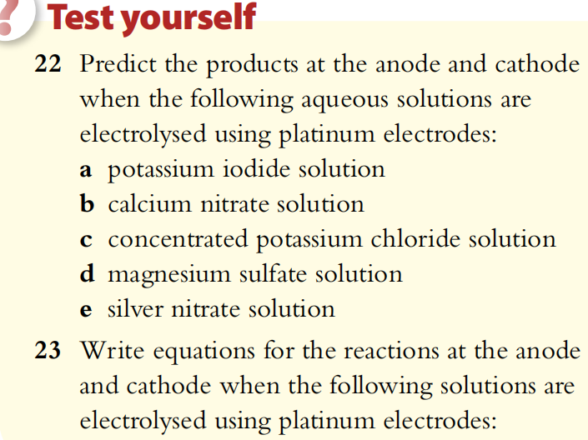
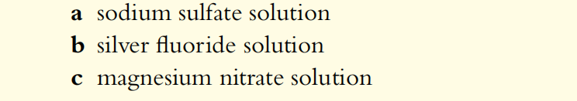
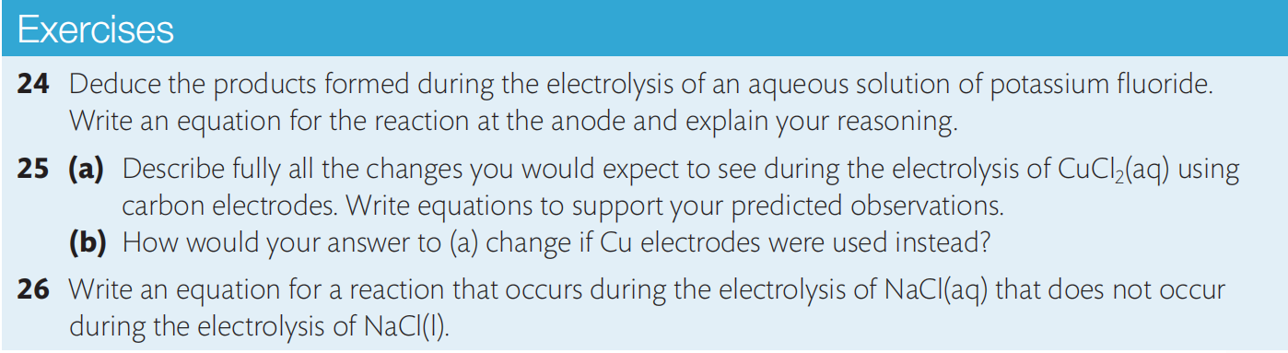

Slide 179

Voltaic Cell VS. Electrolytic Cell
What are in common?
What are different?

Slide 180
Summary of voltaic and electrolytic cells
We have seen that voltaic and electrolytic cells are the reverse of each other.
A voltaic cell converts chemical energy to electrical energy when a reaction with a positive value for E proceeds towards equilibrium.
An electrolytic cell converts electrical energy to chemical energy when an electric current drives a reaction with a negative value for E away from equilibrium.
These relationships, together with the free-energy change ΔG, for the different cells are summarized below.

